Slide 1


Slide 2
Introduction
Our product is ‘Stay Safe Selly’, an application which contains software components with additional hardware components to get the maximum benefit from the app. The system has been designed to aid the wellbeing of University Students, our niche market in particular is students of the University of Birmingham.
In terms of wellbeing, we as a group appreciated that student's lives involve a lot of stress (e.g. Assignments, Social Circles, Relationships, Extracurricular activities…). We believe the last thing students need is a constant paranoia of their mental and even physical safety being affected through the possibility of crime.
Ultimately, we have found this project to be an exceptional platform to showcase our idea of how we would like to see the safety of our students improve, with the potential of prize nomination and perhaps informing further study or development.
Throughout this presentation, we will attempt to explain the product’s features as well as its purpose, detail the process of its development and ultimately justify its existence. The process for reaching this conclusion will be explained in depth throughout the following slides.

Slide 3
Start of project
Before we began, we as a group believed it would be wise to thoroughly examine the lecture notes and identify key features in order to create well designed systems. We learned extensively that to achieve this we firstly need to understand the needs of people, understand their capabilities/limitations as well as technology capabilities/possibilities. We all agreed that we could need to incorporate certain constraints to measure our usability; we agreed we should adopt those used in the lectures slides (Effectiveness, Efficiency, Safety, Utility, Learnability and Memorability). Though secondary to us at the time, we also wanted to make sure our users have a positive experience. This we realized we could achieve through creating a well constructer interface as well as a wider system experience.
Additionally, we took upon Professor Russell Beale’s advice on following the User Centred Design model which included the following stages: Empathize, Define, Ideate, Prototype and Test. We chose this because we believed each segment differentiated from the others well, allowed us to maximize our thought process and consideration for the user whilst efficiently managing our time in each stage.

Slide 4
Idea Generation
With the topic of discussion being well-being, we as a team gave ourselves a day to reflect our personal wellbeing issues. When at a point in time we faced such an issue, we recorded it on our phones or a notepad. Rather than simply rushing through ideas which first come to mind and forcing ourselves to expand on weak ideas, we wanted our ideas to be of relevance and importance and ultimately lead to creating a meaningful product. We also wanted to strictly follow the ‘Empathize’ stage of our UCD model, by putting our own ideas of well-being in the ideas pool, we could put ourselves into the shoes of our user.
The following day, we met in person and gathered and jotted all of our points around a mind map. We found that we often shared ideas, we decided to note these topics down separately as possibly these could be of topics which could be of importance to a market, however without any field research we could not make any conclusions at this early stage. Finally we expanded our own and each other's branches. We found with these broad topics, there was plenty of scope to discuss about. These ideas can be found on the following slide.

Slide 5
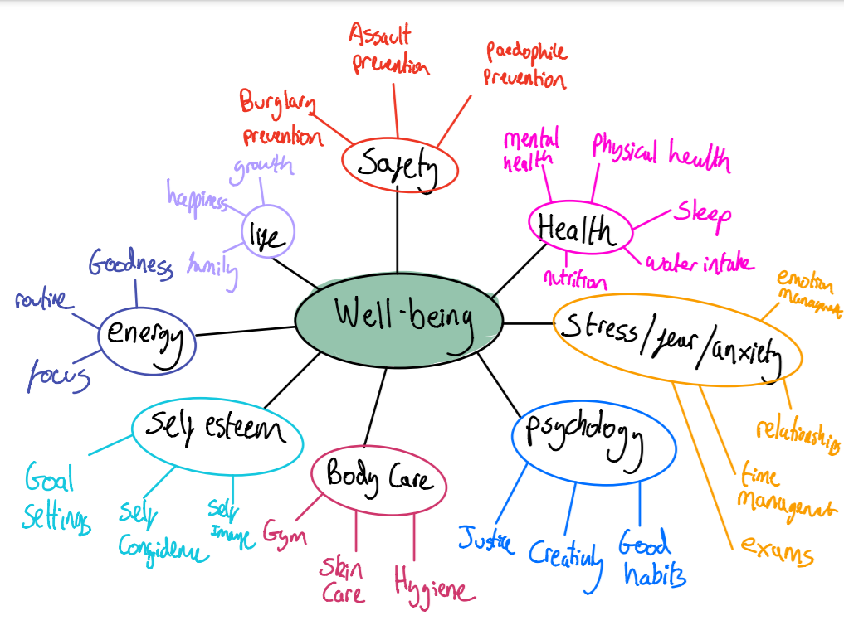
Mind map of Ideas

Slide 6
Idea Generation – Expansion of initial ideas
From this stage, we came up with several abstract ideas and negotiated both pros and cons of each. We found this stage to be both fortunate and unfortunate for us. It was unfortunate for us in the sense that we as a team had come up with many fresh, innovative ideas which all had realistic potential to improve wellbeing and improve lives. This made the process very difficult and time consuming as we were all passionate about our ideas, it was however at this point we gelled as a team and saw the project as a point to do as much good as possible for wellbeing.
We each arranged 24 hours to create a short set of slides of our own to showcase our individual ideas, explaining from an honest point of view the benefits and flaws. We then anonymously put these ideas into a Google Drive folder and reviewed each of the ideas the next day. In our own time, we each made our own judgements and again voted anonymously in which idea we felt had the greatest potential.
After our comprehensive method of choosing an idea, including several rounds, we finally reached a group majority. We feel this method ensured total fairness within the team, encouraged morale in the sense it allowed us to explore the ideas of others in the team in great depth and put ourselves in their position. For the purpose of this portfolio, we have condensed the slides into the following Google Document:
https://docs.google.com/document/d/1DiMbTdKJ1xMfqU0MRpj7Kwj82fwKPPSGma30-AY0mT4/edit?usp=sharing

Slide 7
Idea Generation – Selection of Idea
After a rigorous but fair mannered process, we finally all agreed on the idea of ‘Selly Safe’. The idea initially seemed risky to proceed with as we had identified early potential flaws.
Firstly, we envisioned when creating the personas for our project. A common pitfall would be to create personas which fulfilled our personal needs, this was extremely risk as 2 out of the 4 members of the group currently live in the Selly Oak area. To avoid this issue, we planned for the 2 members of the group who do not currently live in the group to constantly check for bias and in a few occasions, take full lead of the project section where this could have been a significant risk.
Another danger was, is our product really in the ‘Well-being’ category? This raised a significant debate within our group as to whether or not we are creating just a safety app or an app which has the potential to mitigate stress of students. Ultimately, this involved us verifying with a lecturer at a face-to-face help session to alleviate us from our concerns.
It was only after reasoning and slight modifications to the original idea, where we able to pass the checks to continue with our idea. This included sections such as group walking which could justify students feeling safer in greater numbers. Other modifications included a FAQ section which allowed students to feel more confident in their actions in the prior and event of crime. Though we had initiated these ideas, we still took into full consideration we are designing a product for a market. For this reason, we held our ideas loosely and we were willing to adapt in the case that these ideas may not be looked upon as useful to our target audience in our field research.

Slide 8
Idea Generation – Initial Concept
This slide will attempt to conceptualize our design at this early stage of the process in as much detail as possible. After extensive feedback and group discussions, at this early stage we have decided that our application should feature 3 brief categories but this not currently set in stone. We hope to expand our ideas using information from our research.
The main section would contain an interface which connects the hardware components to the app. In this section, the user has access to see updates over the current state of the sensors and camera.
Another section was to form some sort of group activities, as we thought as students there would be strength in numbers. We idealised some form of collaboration between students but had no idea how to do this.
Another feature which we have discussed in meetings is an option for students to see ratings of safety in general areas of Selly Oak. With this information, students will be able to make informed choices of where they decide to live for the duration of the year. This will use machine learning, where information such as light levels, previous crimes and other parameters would be used.

Slide 9
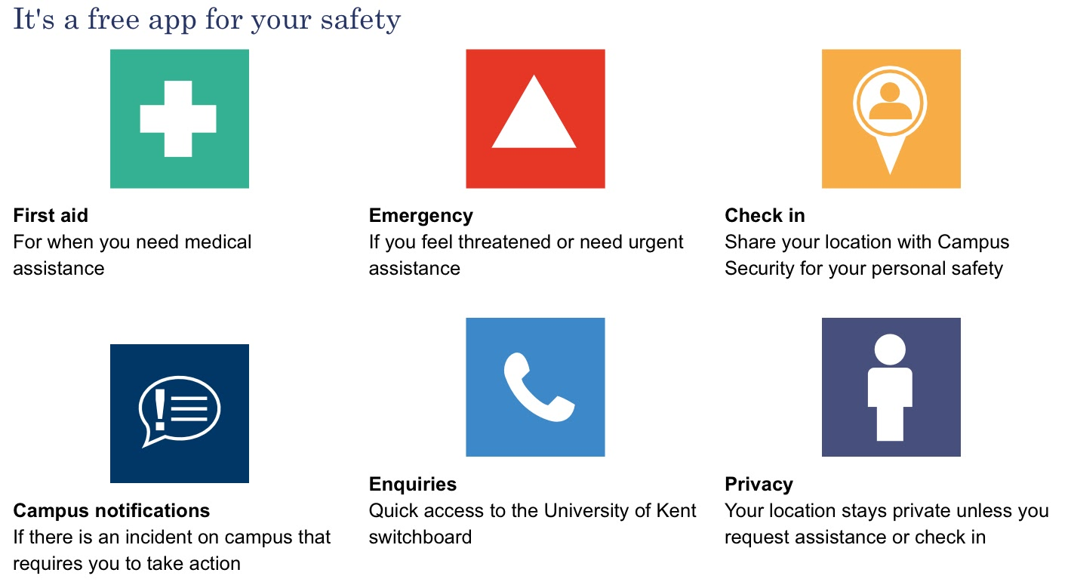
Idea Generation – Online Research
As a group, we left ourselves to our own devices and began searching the internet for ideas of a similar calibre. Firstly, we began by using quite broad search terms to maximise our chances of finding a relevant item. In terms of this, we found some items but they were not strictly relevant. From here, we decided to refine our searches to find ideas of a similar sort. One app we were surprised to find was ‘Safe Zone’, this is an app by the University of Kent and is branded as ‘a free service to help give round-the-clock safety reassurance to staff and students’. Although we were impressed that a university had taken such action, unfortunately we as a group did not feel it would suffice to alleviate the concerns of our ideal target audience. Safety features:
We as a group decided to explore this app further and decided some features were indeed credible, we were inspired to include some features but improved in order to reflect in our current environment. An example of such a feature was Check in, which we thought could be very beneficial in times of needs but instead of Campus Security being alerted solely, we thought perhaps using the police force may also serve a good purpose.

Slide 10
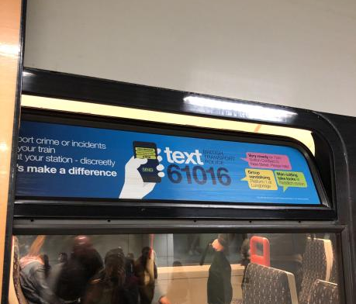
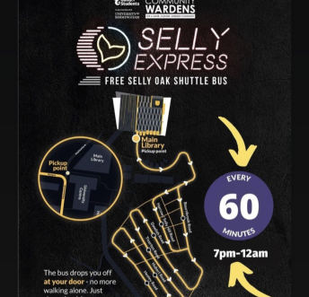
Idea Generation – Additional Research
In additional to our online research, we found great value in the wealth of information acquired and expanded this to other resources. We as a group visited the library and asked Librarians for relevant books. We began researching although we could not find much more information, this was either because no such technology exists, or more realistically, our topic was not accessible in books. In hindsight, we agreed it was not our best use of time. Fortunately, during our commute to university we found other resources, though not strictly relevant but of some relevance to our topic of safety. Additionally, we were made aware of a service provided by our own university which inspired us further. We later decided to use this research in the form of ideas for our field research.

Slide 11
Idea Generation - Evaluation
In hindsight, after looking back at our method of idea selection, we found there to be both benefits and drawbacks. An obvious drawback was that some members of the group had contributed more than others, we believe this was perhaps because it was possible some members of the team were not so clear in the concept of the chosen idea so experienced some form of demotivation at the beginning. However, as the early weeks progressed, it was clear that after idea generation, all members being much more involved and became a lot more proactive. We found group exercises such a mind map jotting allowed use to interconnect our ideas as a group as we expanded others ideas, further adding to our imagination. This allowed us to create a healthy amount of ideas, which further had a benefit of us producing higher quality questions for our interview and questionnaire. We had a very clear idea of our problems at this early stage and were aware if we took full advantage of our field work, we would learn a lot of valuable information which allow us to have a turning point in the project.

Slide 12
Questionnaire
As an initial way to expand our own knowledge of our idea, we designed a questionnaire which asked general questions which would contribute towards our final solution. We originally only asked a small group of people to fill out and give feedback on a five-question pilot survey. Unfortunately, we did not receive the type of feedback we were hoping for so we began making slight modifications but now without the benefit of receiving feedback. We did not ask for any feedback because we decided to release our questionnaires as soon as possible, this was due to the time constraints already existing due to a member of our team falling behind in his tasks due to illness. We each set out to receive at least 10 responses, in order to create a representable set of information. We also used our best efforts to randomly assign the questionnaires to avoid a common distribution in a particular set of answers. Our method of giving out questionnaires was by using Google Forms, simply because of its ease of use and paperless properties which was especially important during a world-wide pandemic.

Slide 13
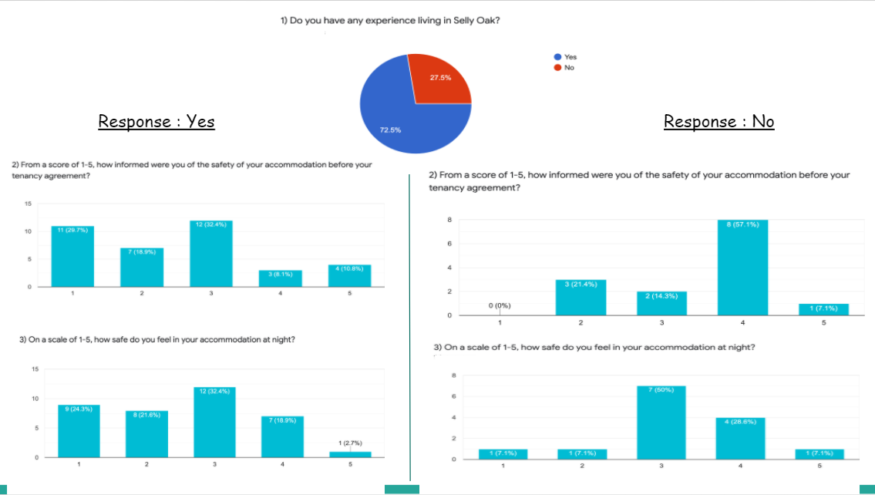
Questionnaire Graphs

Slide 14
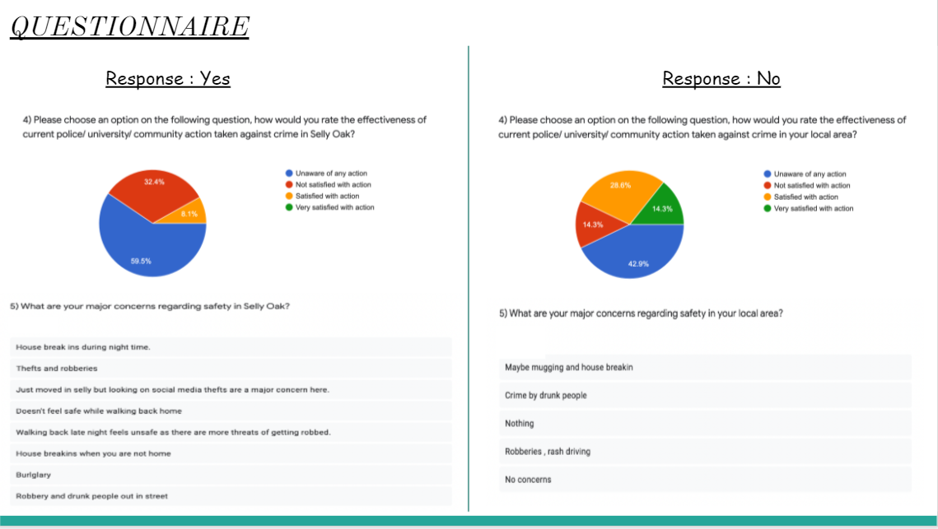
Questionnaire Response

Slide 15
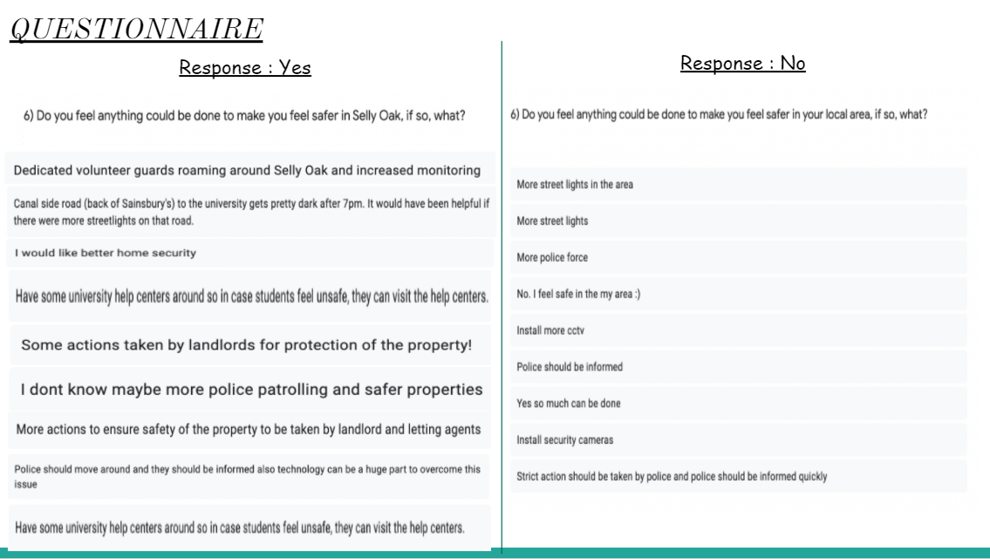
Questionnaire Response

Slide 16
Questionnaire Outcome
From our questionnaire results, we were able to learn what the major safety concerns were of people living in Selly Oak in addition to other areas where students reside. We thought this would be wise and student town crime is universal and we didn’t want the possibility of a learned stigma to be the root of a lot of common answers in Selly Oak.
One valuable piece of information we learned was approximately 80% of students were uninformed/partially informed about the safety measures. We also quantitively leaned that 78% of students living in rented houses in Selly Oak did not feel safe living in their houses.
Of all of the people who were residing in Selly Oak, 60% of them were unaware of what actions were being taken for their safety. 30% of them were unsatisfied with the actions being taken in the current situation. Quite a few people were just satisfied with the actions being taken.
From the outcomes of the questionnaire, there were quite a few common issues that everyone had. The most common being darker streets, house break-ins, less police patrolling during the night.
From the most common issues, we concluded to make something that will help people know if their house is vulnerable/at risk for break-ins and inform police about the risk as installing street lights was infeasible.

Slide 17
Questionnaire Evaluation
All in all, after reviewing the process of our questionnaires, we were disappointed with our progress. Although we distributed them on time, asked to a large number of people, asked clear and non-leading questions, unfortunately we did not amount to a lot of valuable information which would steer our direction in the app prototype. We wouldn’t say the information is redundant, but it did not really tell us too much more than what we already knew. This could quite possibly be because we are a direct audience for our intended project.
The most valuable thing we did learn however was that compared to people who do not live in Selly Oak, where almost 70% scored either 4 or 5 for being informed about their accommodation before their tenancy as opposed to 20% of those residing in Selly Oak. We as a team began exploring this problem in further detail, in an attempt to create some sort of resolution.
Additionally, with 60% of people being unaware of current action, we felt we could incorporate our platform to accommodate for this issue. We began exploring ideas of creating a direct form of contact with support services.
Because we did not feel we acquired the quality of information we would have hoped for, we decided to redeem ourselves through the form of interviews.
Overall there were many advantages specifically to questionnaires such as: Easy to share widely, there was no need for individuals to administer them (scale roll out), online efficient processing of results and a simpler access to international audiences.
Disadvantages included: Vague idea of who was answering them, hard to tell if difficult responses were given, there was no way of assessing body language or emotional response and possibly the questionnaire did not format well on all devices.

Slide 18
Interviews
With limited information on our hands, directly from our target users, we finally agreed to form questions to use for an semi-formal interview. We decided to be formal to achieve in depth answers and receive quality information, yet we modified our tone and style of language to allow the interviewee to feel comfortable and perhaps provide more open honest responses.
Unfortunately, it was very difficult for us to find a suitable audience as many people were not available at the time to participate. We could only assume this is because many students were busy with assignments or had other commitments. In the end, we decided to ask on the university’s ‘Fab ‘n’ Fresh’ Facebook page which contains a group of approximately 30,000 members. We first made a post and were disappointed, again, to receive no interest. As a team, we decided providing Amazon vouchers as an incentive would provide some sort of motivation to complete our interview and this worked. We found approximately 20 students wanted to participate, although we would have liked to interview as many as possible, with a £5 cost per interviewee and time costs, we decided to interview 4 people. We put all 20 names into a random generator and successfully chose 4 people who were happy to meet in person.
We were unfortunately not allowed to video record the interview on request of the interviewees, but were allowed to record the audio. Our interviews were quite lengthy and would almost be impossible to fully transcribe accurately. For this reason, we have paraphrased the interviews to cover the main points.

Slide 19
Interview 1
Interviewer: How do you feel living in Selly oak?
Interviewee: I enjoy it in terms of the night life and my friends are around, but I am always really worried about my safety and I can never get it off my mind. My friends don't consider me an anxious person but when I keep seeing people on Fab 'n' Fresh telling people they have got broken into and have had all their expensive belongings taken, I really get scared.
Interviewer: What is your opinion on Stay Safe Selly?
Interviewee: I think it's a really good concept and I appreciate that the University is providing such services, but I don't think it's completely practical. For a start, the buses are quite small and overbooked so many people keep having to wait on an hour to catch the next one which is really inconvenient. Also, the fact that you have to wait every hour is again quite a hassle. I really hope the University can create some sort of an alternative solution which is safe and can cater for the extra demand.
Interviewer: How would you protect yourself in a crime event such as you described earlier?
Interviewee: I think this is where a problem lies, I have no idea what I would do. I don't think I would fight back but I would probably run out and cry. I think the university should give some advice or something at least because this happens so often, and I think the police should intervene to by doing something.
Interviewer: Do you feel the university can take any reasonable action?
Interviewee: I pay 9 grand a year and I really think the University has the capability of doing something to help us at least. Without us, surely they can't function?! They should invest in home safety measures for us students so we can at least feel safe and have some confidence. Not all of us can afford expensive university owned accommodations, security shouldn't be a discriminator of safety in my opinion!
Interviewer: How would you like to see safety improve?
Interviewee: Well I'm not part of the police force or a member of security, but I do feel some kind of cameras or locks would be quite good to have. I mean, don't get me wrong, it will probably be expensive but like I said, I am paying 9 grand a year! An extra perk would be if we could connect it to MyUOB app or something, that'd mean we could check over our stuff when away from home and that would be amazing!

Slide 20
Interview 2
Interviewer: How do you feel your safety could be further improved in Selly Oak?
Interviewee: I think that's a very good question, I don't think there is much more I can do from aside checking my doors and windows are locked at night. I am very forgetful sometimes and have been told off by my housemates for forgetting, would a device which helps you remember exist? That would be my answer but I'm not sure how we could make it happen.
Interviewer: In an ideal world, what technology would you like to alleviate your concerns?
Interviewee: Well aside from the auto locking system, I really think some sort of map technology would be quite good, like Google Maps. What I mean is, maybe we could see some hotspots to avoid in Selly Oak, like areas in which crime has just occurred or prone to danger?
Interviewer: Those sound like some excellent ideas, what sort of interface would look good in your opinion?
Interviewee: So maybe a street could be coloured like when Google Maps tells you, you are in a congested road or some kind of radar? In my opinion, the more detailed the colours would be, there better for personal reasons such as my disability.
Interviewer: Could you please explain what you mean by this?
Interviewee: I was actually born with a recessive gene which makes me somewhat colourblind, it means I really struggle to differentiate colours unless they are well contrasted. Even the biggest companies don't take into consideration us colourblind people when a lot of us do exist! So if good colour choices are used, and not to mention, colours which can be gently and easily viewed by the eye at late nights when an app like this could be used.

Slide 21
Interview 3
Interviewer: Did you ever feel like you are not sure if you have locked the door or not when you left the house?
Interviewee: I always have those moments when I think I locked the door but I didn’t so I would go back to the door and double check if I locked it. This obviously consumes my time. Especially when I am in a hurry, sometimes I forget and panic in stress.
Interviewer: Tell me about a time you had to walk home alone at night. How did it feel?
Interviewee: There were many times when I had to walk home alone from library at night after many hours of study. It was scary and nerve racking. It is really dark and sometimes I have a feeling that somebody is following me in the back.
Interviewer: What do you know about the safety of your street and the areas around it?
Interviewee: I don’t know that much about it. I feel like it is pretty dodgy as it doesn’t have many lights. Nobody informed me about the area that I will have to live in. I actually got surprised once I moved in my new accommodation and when I was walking at night I felt scared. I couldn’t do anything about it as I signed the contract already.
Interviewer: Do you know what to do to protect yourself and your house?
Interviewee: No, I actually don’t know that much about self-defence and safety advices but if I would have this information handy I would probably read it before getting to experience it.

Slide 22
Interview 4
Interviewer: What is your opinion on crime in Selly Oak?
Interviewee: I haven't really experienced or see any myself to be honest, I've heard it through word of mouth though but I think it's just one of those things that will always get passed around. I'm not saying it doesn't happen, I just haven't seen any with my own eyes.
Interviewer: What action do you feel our University could take?
Interviewee: Well I'm not sure there is much they can do, unless if they employ more security officers or get in contact with the police. Although I do think that a lot of police officers are around but they're not doing too much. Maybe if there was a way we could report crimes faster so they could come and catch intruders or vandals?
Interviewer: Would such a feature aid your wellbeing?
Interviewee: Definitely, it would give me a sense of security and knowledge of action being taken. It would be extremely useful if we could be notified of local intrusions too, like get a message or something so we could stay prepared. So like if my neighbours or me were being burgled, I could get like a text message or phone call telling me to be safe.
Interviewer: What is your opinion on a security device which you can install at home for your safety?
Interviewee: I would more than welcome the idea as I feel I could do with a bit more safety, I have to admit that the thought of burgled has made me feel quite low sometimes. I can't really tell my friends because I think they might make fun of me, but I do it is definitely a topic which needs further discussing and help would definitely be accepted by me.
Interviewer: Is there any other sort of safety feature you would like to see in an ideal world?
Interviewee: Well, I just think a way of contacting emergency services in a fast way might be quite good. When you are being burgled, you'll probably thinking about protecting your life rather than calling the police. So something that could automatically call the police or something when danger has been detected might be very useful.

Slide 23
Interview Outcome
From the interview, we learned a lot of information which has greatly enriched our idea of what we want to include in our app prototype. Although most of our valuable information has come from 4 interviews, we feel through incentivizing our interviewees we have received better all rounded responses where information is perhaps more accurate. In comparison, it is possible that people may have rushed the questionnaire for the sake of completing it.
We found the interview was excellent for us in reinforcing our ideas and our prior knowledge and concepts and hearing it from our direct target audience improved our confidence. Overall, we learned that students would like more information and support, they would like some sort of a device to aid safety (e.g. a camera device, auto lock device ), they would like to be better informed of areas of concern to perhaps reroute, a system to make contact to emergency services and our idea of group booking was finally feasible which we proposed at the early stage. We held onto these loose ideas to take onto the design stage which we completed further down the project.

Slide 24
Interview Evaluation
All in all, up to now, the interview has been our greatest success. We managed to receive coherent, valuable information which has provided with a realistic vision of where we want to take our next steps. When designing the questions guide for these interviews, we took quite a lot of care to make sure they were not leading in anyway, as we wanted to ensure our users opinions were not accidentally influenced by us. We believe this is evident as we now have an array of new fresh ideas which are possible to be prototyped using both software and hardware, the requirements of the assignment. Using our UCD model, being able to empathize with our target audience was a great benefit as we are already students at the University of Birmingham and 2 of us lived in Selly Oak. We as a team agreed the ideas were feasible and certainly would mitigate our own stresses in the sense that we would feel much safer and more confident in acting given that we were involved in the event of a crime. Also, to make sure the interviewee did not deviate too much from the topic, we mentally kept note of the topics we wanted to cover and extracted the relevant information for what we put in the slides.

Slide 25
Personas
Once we had collected the data from our questionnaire and interview, our idea of our target audience had vastly improved. The information collected allowed us to envision how our target audience would use our service, and what characteristics our personas would be likely to have. Following through the models used in the lecture materials, we decided to create 3 personas using the 3 levelled approach:
Primary/Focal persona
Secondary persona
Anti-persona/Exclusionary persona
We believe we have produced representative data for our project as we were able to identify and isolate behavioural variables, map our interview subjects to behavioural variables and identify significant behavioural patterns. Using these, we were able to synthesise characteristics and significant goals.
For our first persona, we wanted to capture our idea of the main user of the app. This was someone who could make full use of all our offered features and would experience a real improvement in their wellbeing. For our second persona, we wanted to represent a group of people who are transitioning to a group who will soon be able to take advantage of our services, a group who should be aware of what we offer. The last group was made to represent people who are not directly influenced by our service but have the option to use a few of the services, in our example we have the FAQ section.

Slide 26

Persona 1 – Primary persona
Name: Priyanka, 3rd Year Computer Science Undergraduate
Key Distinguishing Feature:
Age 21.
Single.
Lives in Selly Oak area.
Very proficient with technology e.g. Smartphones, has access to a high speed internet connection.
Goals:
Wants an online platform to be notified of local break-ins.
Wants safety measures (Hardware & Software) to take place to reduce the likelihood of an intrusion.
Wants up to date information of surroundings and on what to do in the event of an attack.
Summary:
Priyanka is an undergraduate student who has experienced severe anxiety since moving away from the University’s Halls of Residence, where top security measures had been put in place. This fear was further heightened when Priyanka’s closest friend who lives on the opposing street was burgled, where all of her expensive belongings and items with sentimental value were stolen. Priyanka has contemplated leaving her residency until she can be rest assured that her safety improves, this will however incur in her wasting money as she has been tied into her housing contract in Selly Oak. She is looking for a solution which will inspire confidence in her and her family who are very concerned with her safety.
‘I feel absolutely terrified when I am both, in my student house and when I am away!’

Slide 27

Persona 2 – Secondary persona
Name: Alina, 1st Year Law Undergraduate
Key Distinguishing Feature:
Age 20.
Single.
Transitioning to move into Selly Oak area.
Proficient with technology e.g. Smartphones, has access to a high speed internet connection.
Goals:
Wants to be made aware of local history crime rates before moving in.
Wants to choose a house where the risk of being burgled is minimized (quantitative data).
Wants to be made aware of her house situation when she is outside.
Summary:
Alina is a 1st Year law student who has begun searching for houses for her 2nd year. She is very aware that Selly Oak is described as a rough area and she should be very careful with where she should choose to live. She has been told to avoid particular areas through word of mouth, but this information has not been to helpful and has just instilled fear into her. Alina would like to compare different areas in advance so she can make an informed decision in where she will live for the academic year. Alina would also like to know the status of her house from her phone so if she is away at night and has the knowledge that her house is broken into, she can take the right course of action.
‘I love the occasional night out but I think I'll get really anxious every time whenever I leave my house!’

Slide 28

Persona 3 – Exclusionary Persona
Name: Jenny, 2nd Year International Relations Undergraduate
Key Distinguishing Feature:
Age 20.
Single.
Commutes from home every day.
Proficient with technology e.g. Smartphones, has access to a high speed internet connection.
Goals:
Wants to ensure her friends are safe, and she herself is when she visits her friends.
Does not require information about the safety of Selly Oak houses.
Is not interested about reporting of break-ins, in Selly Oak area.
Summary:
Jenny is a 2nd Year International Relations student who lives in Birmingham, but not in the student town. As she lives close to the University, it was not economical for her to live in Selly Oak, however she frequently visits her friends who live here. Many of the services of the app are not required for her, such as monitoring of the house or score of Selly Oak properties but features such as group walks for later hours or FAQ for break ins may be of some use to her.
‘I don’t actually live in Selly Oak but I do often visit my friend’s houses’

Slide 29
Personas Evaluation
We as a group decided to use personas design, primarily because of the main benefit that it stopped us basing our design on what we wanted. Despite us being university students ourselves, not all of us as a group were accommodated in the heart of the Selly Oak town, some of us were accommodated in Student Accommodations where crime rates were near to null.
By using personas we found them to be an excellent asset to us. We found that we could represent complex data in such a form which was compact yet representative. In essence, we found this to effectively encourage a user-centred approach which provided a clear vision of our user using our product. Other benefits included focusing attention on our main user groups which avoided common pitfalls of choosing extreme edge cases which diverted the attention of our main goal.
As with all the advantages, we did have to work around several disadvantages. Firstly, with the compactness being an asset, it could also be viewed as a double edged sword. We found in the developing process, it was relatively difficult to establish the right set of personals in comparison to other research methods. This raised issues such as time costs which affected our judgement on how long we should prioritise other components of this project at this early stage. Another disadvantage was the danger of ‘persona reuse’ as to begin with, we had a specific audience with. This meant we had to particularly think outside of the box to ensure we created personas which had the right target users with relevant goals. This of course came with the temptation of making up the users to suite our needs, for this reason we took extra concern in making sure we followed our market research in great depth.

Slide 30
Scenarios
In addition to personas, we found scenarios to be very useful for the ‘Define’ aspect of our User Centred Design model. When we created our scenarios, we were strict in attempting to be concise and we prioritised breadth over depth. Additionally we assumed our product at an early stage despite not reaching the design stage, we found this was a pivotal reason for using a scenario. We attempted to describe the goal as to why we performed the task. We hope this could be used to conceptualize our product in such a way that it represented various types of users and different user needs.
We also used scenarios to imagine possible events that might happen to the user and to see how the product can help in those specific situations.
The aim is to truly understand the user in order to create an effective solution to help them achieve their goals.
We found that scenarios were complementary to the personas which we used in earlier slides.

Slide 31
Scenario 1
“Priyanka is a third-year student at University of Birmingham. She often stays a long time in the library and walks home at night alone. Moments after she leaves the library she starts to feel anxious that she has to walk alone all the way to her house in Selly Oak.
Fortunately this time she opens the Stay Safe Selly app and books in a group walk with the other people from the university that live in the same area.
On the way home, Priyanka sees some dodgy people but she feels safe as she is not alone this time.
Priyanka arrives home safely and also she managed to interact with some of the group members and make some friends.”

Slide 32
Scenario 2
“Alina is a first year student at University of Birmingham. Summer has come and she has to find an accommodation. As most students choose Selly Oak because of the price and being conveniently close to the university, she decides to find a place in the area.
She heard rumours that Selly Oak is common for burglary and she would like her time at the university to not be a constant fear for being robbed. She downloads the app and passes all the security checks in order to get access to the system. She scans the area for the safest zones and for the accommodations that are on Stay Safe Selly.
Based on the information gathered, she chooses the house with the lowest risk of being robbed.”

Slide 33
Scenario 3
“Jenny is a second year student at University of Birmingham. Being close to the university, she decides, during the day to go to Aldi to shop for her groceries and after that to wait for her friends in the front of the house. Getting closer to Aldi she receives a notification on the phone of a possible burglary on the street where her group of friends booked an accommodation this year.
Being a good friend and also knowing that her friends are in the lecture, she decides to stay safe by not going to the house and also decides to alert her friends. By the time her friends were back, the police were already at the place and arrested the suspect.
The crowd was relieved and Jenny felt that somebody takes care of her and her friends. Also the people around observed the situation and decided to download the app as well.“

Slide 34
Scenarios Evaluation
We initially felt it was risky to create a scenario when we had not finally confirmed what our final product would have been. However, having taking recommendation from online sources, we learned that it was essential to include the product in the scenario regardless of the design stage. This initially took a bit of acceptance from our part but we did in the end. So ultimately, needing the co-existence of a prototype was somewhat of a disadvantage to us.
Difficult to generalise from scenarios, abstract use cases.
We found scenario management was difficult.
An advantage was that vivid descriptions of end-user experiences were able to be created which focuses on reflection of the design.
We found that the scenarios concretely fixed our interpretation and solution however as they are open-ended, we would they were easily able to be revised.

Slide 35
Autoethnography
Whilst our original intention was to carry out Ethnography, unfortunately due to a lack of participants and availability due to the pandemic, we transitioned to Autoethnography which was of some use to us. We found it was helpful for gaining empathy for the users, it also lead to some design implications.
To further understand the user we decided to bring the study to a more practical experience, trying to feel what the students might feel while walking alone in Selly Oak and also observing possible thefts going on.
We conducted the research by walking in group into the streets of Selly Oak at night hours.
Our aim was to see if any of us would feel unsafe and if there will be any incidents that we can observe. Based on ‘Fab ‘n’ Fresh’ reports, we decided to take the following route of reported incidents:

Slide 36
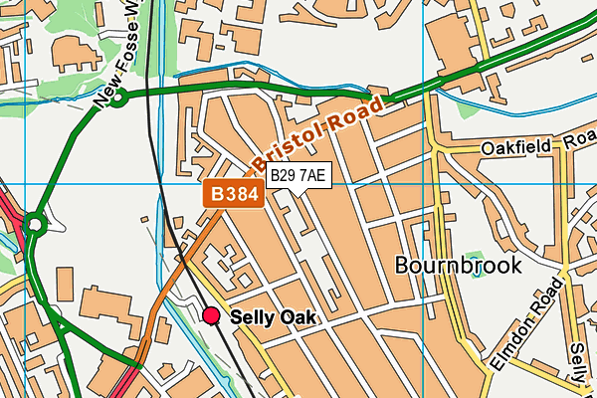
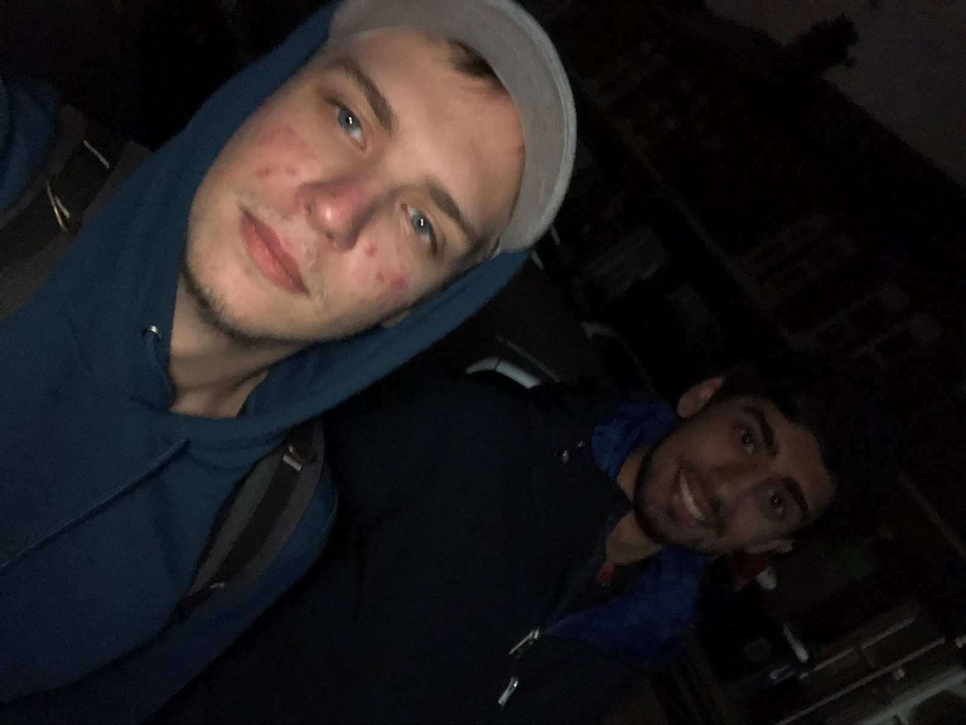
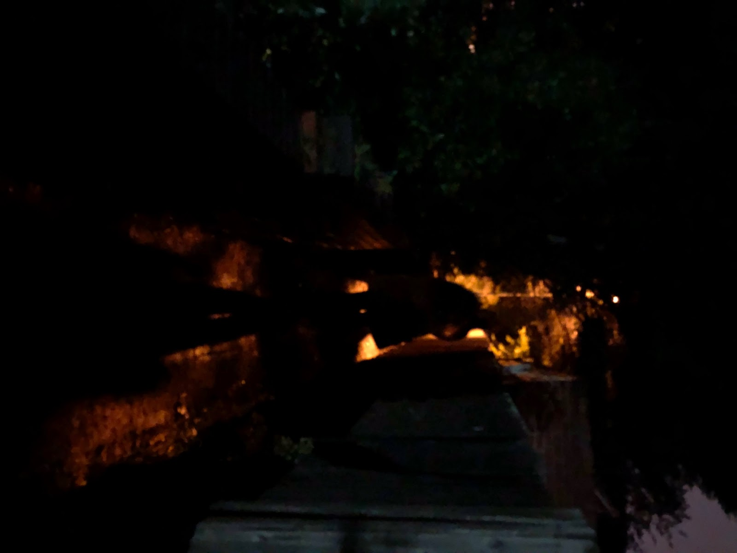
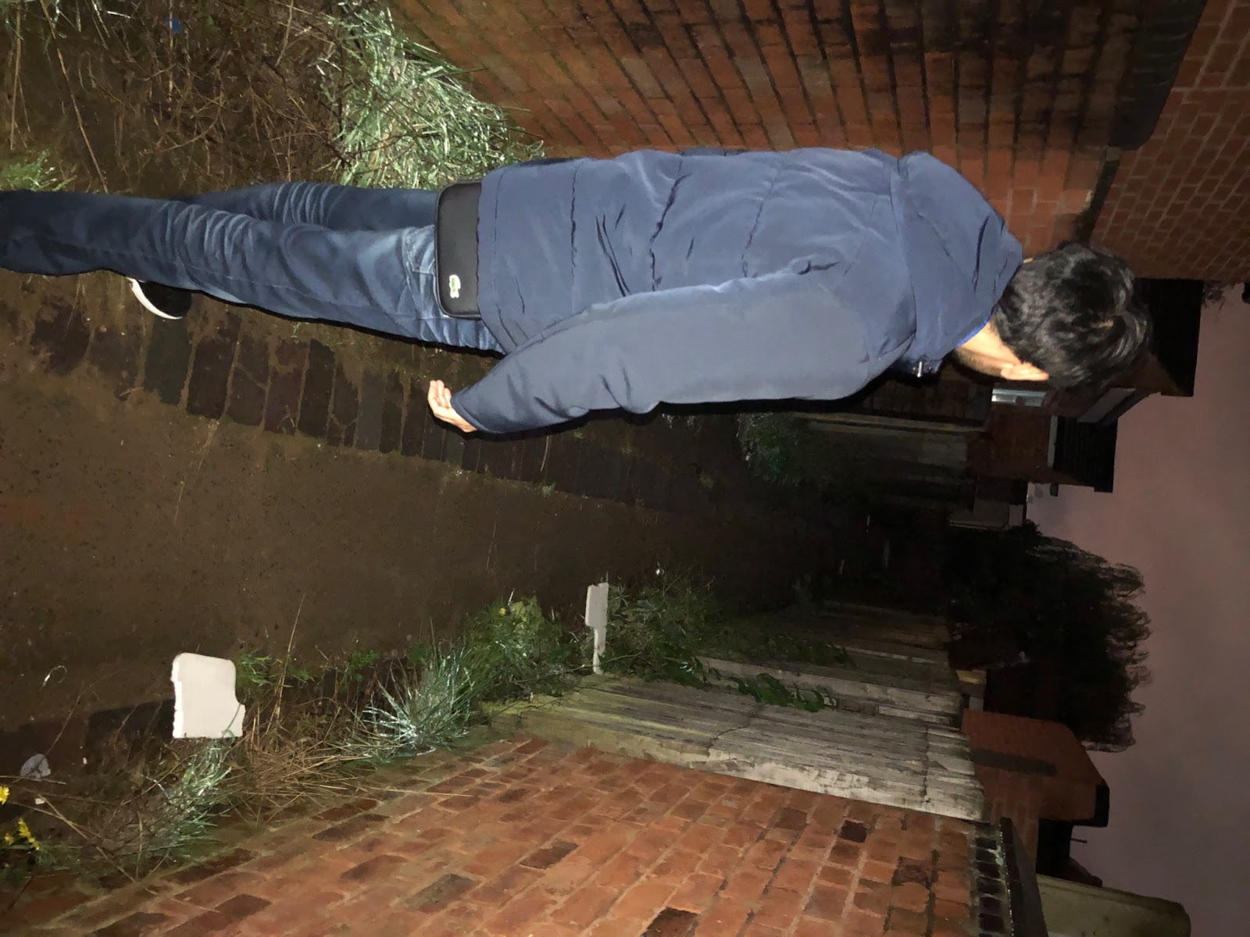
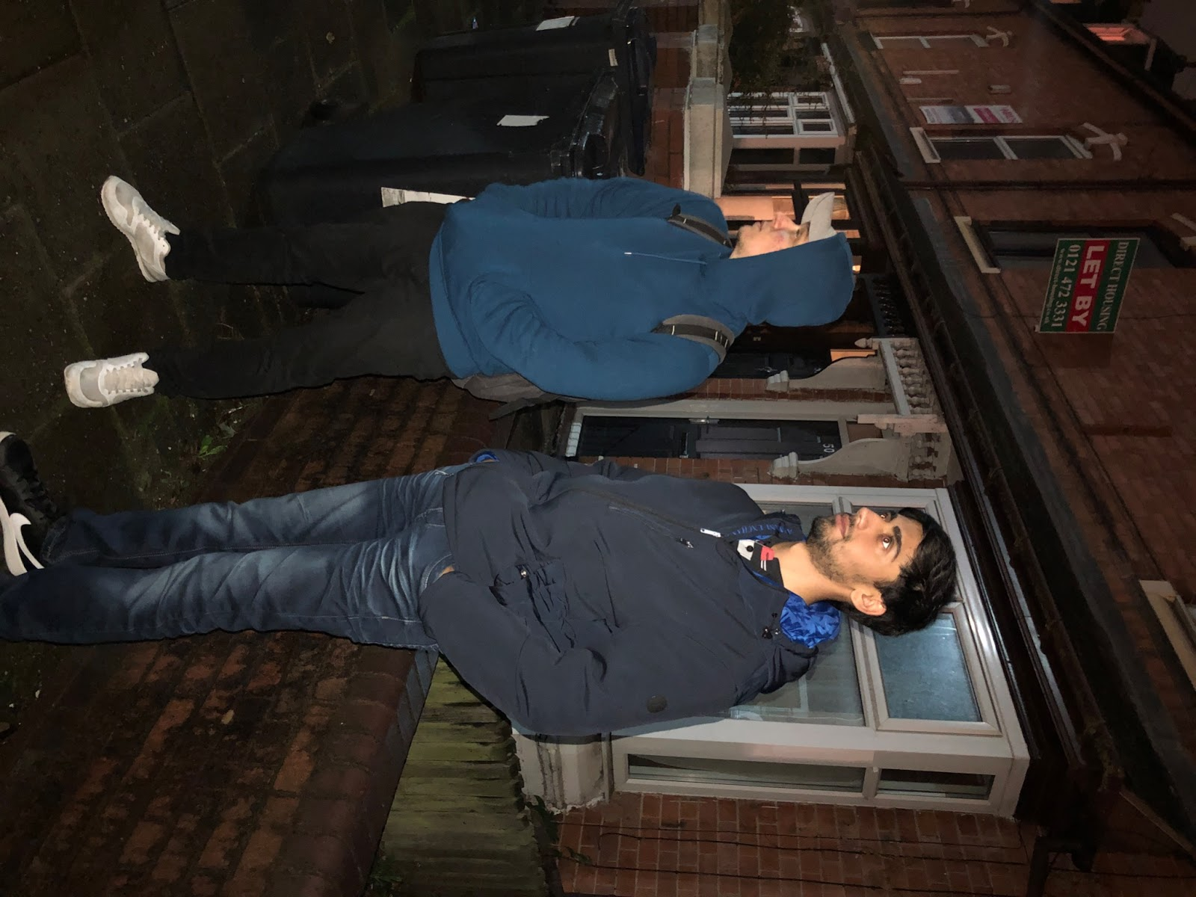
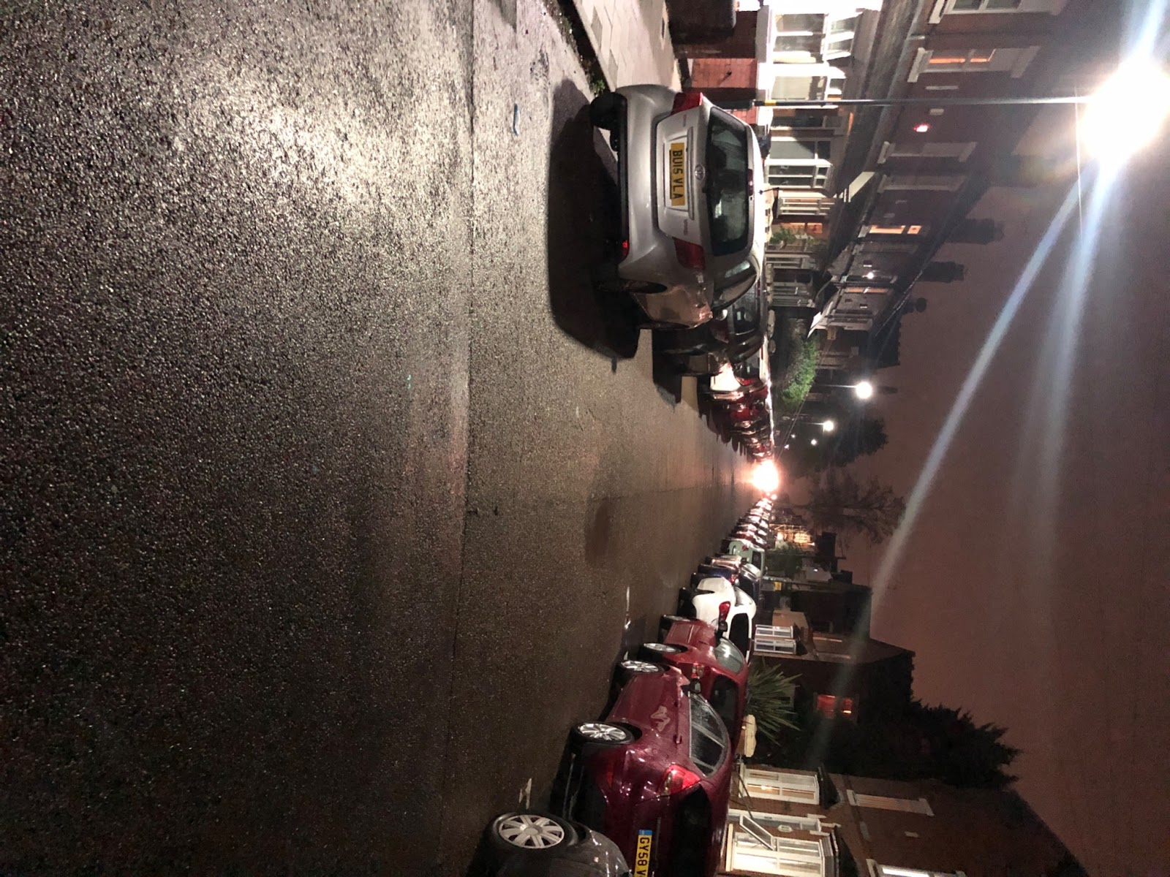
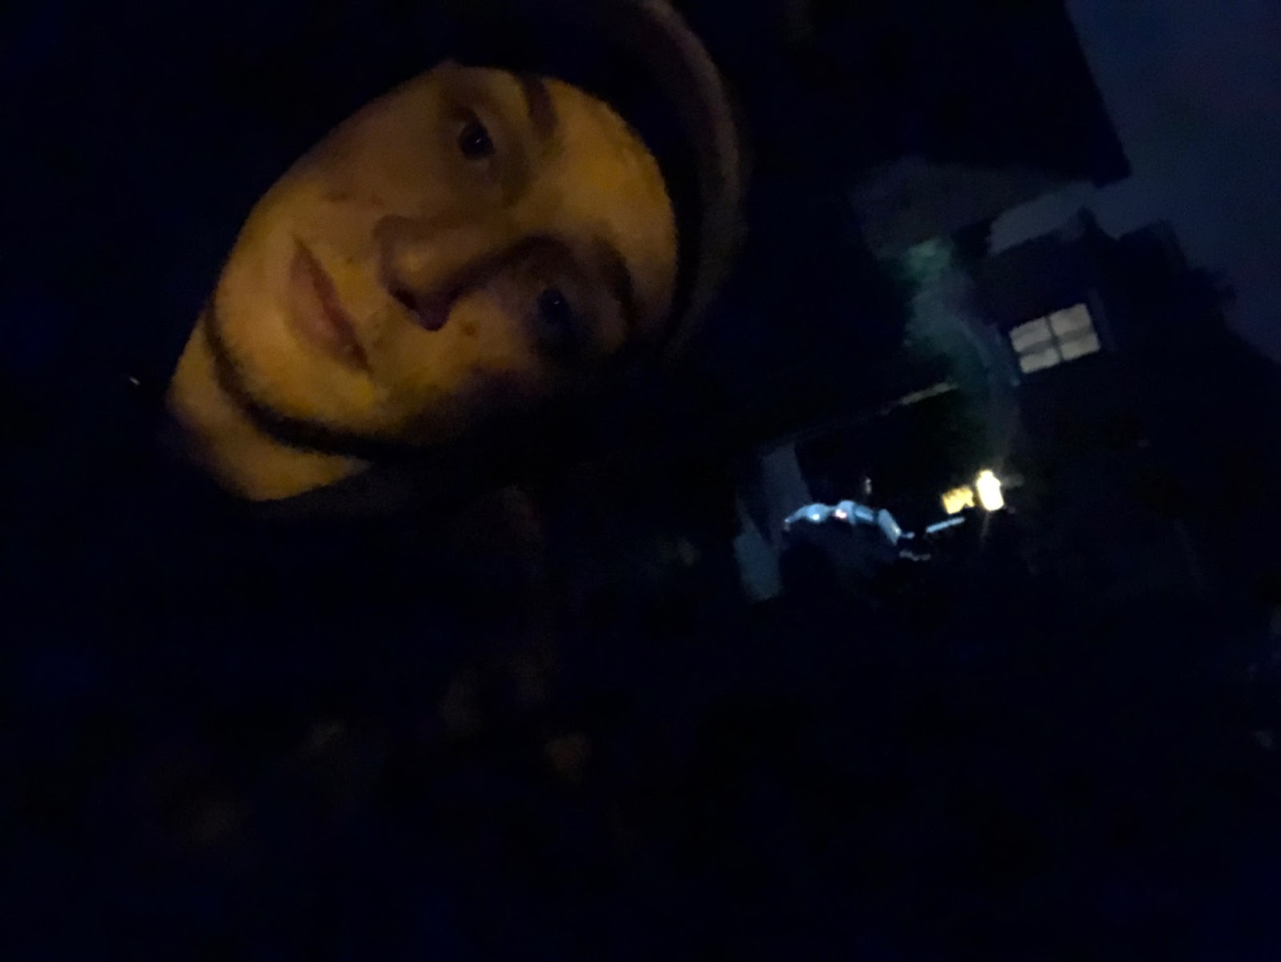
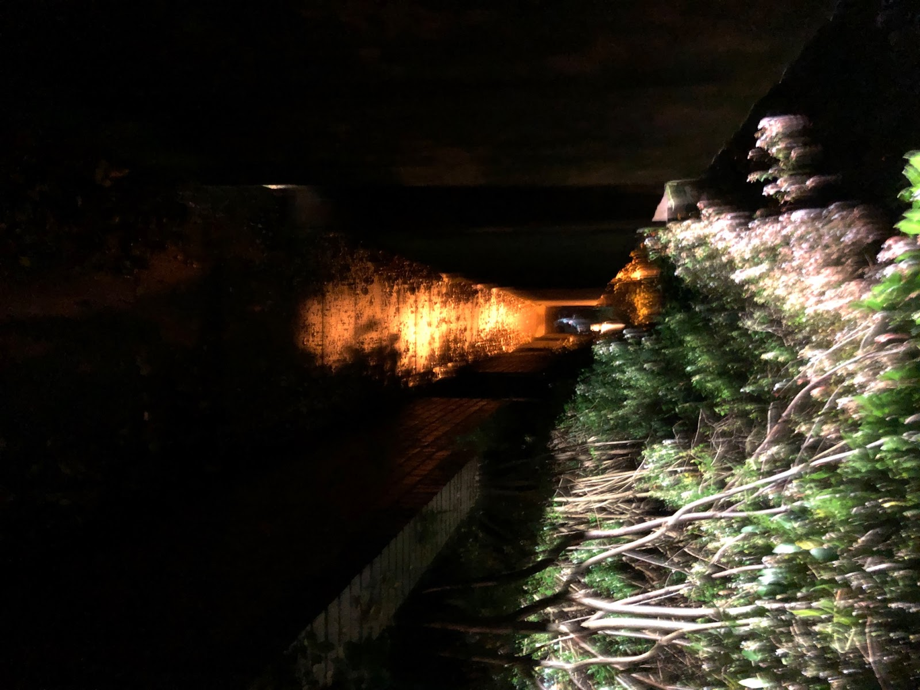

Slide 37
Autoethnography Evaluation
As interesting as it was to conduct the autoethnographic study, we didn’t find this stage of the project very useful. This was the case because of the following points:
The group being formed only out of males, we could not experiment the same feelings that a female would feel while walking alone in the night, on the streets of Selly Oak.
As we tried to safely conduct the experiment, we did not really fully feel the experience of walking alone in the night. We could not truly understand user experience, we additionally had a fixed and prepared mindset which psychologically may have given us an advantage. We could not identify any thefts and robberies going on during the experiment. (fortunately).
It was not time efficient as we had to wait until night to perform the observations. The time limitations did not allow us to perform this stage at the highest accuracy possible.
Although we were in a group while we did the autoethnography stage there was still a risk of putting ourselves in danger.

Slide 38
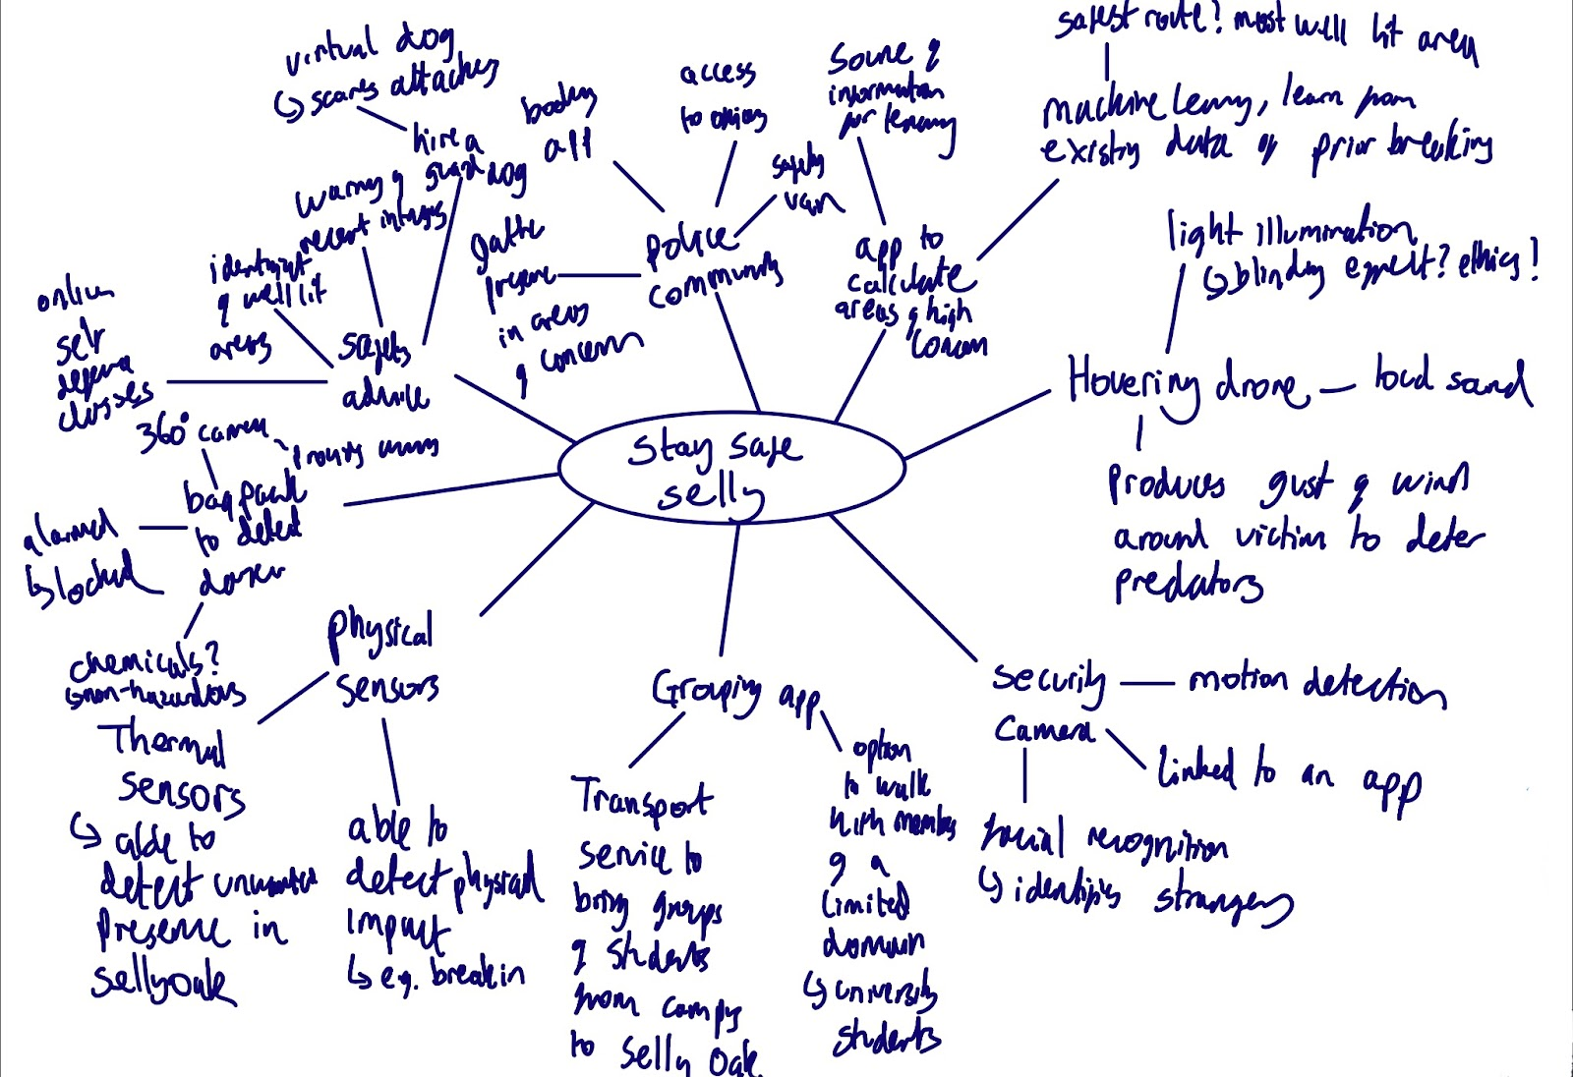
Exploring the design space
For this section of the project we split into 2 pairs and produced as many ideas as possible within 20 minutes. We limited ourselves to this timeframe to ensure we would not only be efficient in our time management, but also so it forced us to think in such a way that our ideas would have wide scope.
Here is one of the 2 sets we had created. We took inspiration from ideas in our field research, but produced equally valid propositions in our opinion.
We then further expanded these ideas using ‘The Six Hats’ framework for thinking, to expand our ideas.

Slide 39
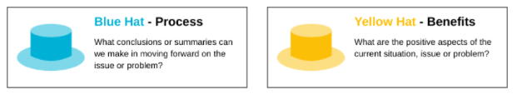
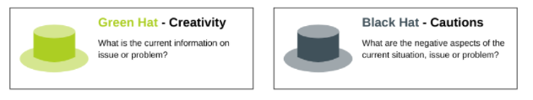
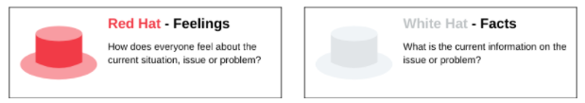
The Six Hats
We decided to use this thought process to go above and beyond the syllabus. The six hats is basically used the premise that human brains thinks in a various number of ways which can be challenged, and for this reason it can be planned for use in a structure way such that it allows one to develop tactics for thinking about specific issues. In our context, we used it for out design issues. We found our to be surprisingly extremely useful as it allows us to continue empathizing for our users and think abstractly in different issues. After using Six Hats, we finally decided on our final concept for the first prototype. Please see our ideas here:
https://docs.google.com/document/d/1Yqr4mJ4Y395mwnE2MfFufZkpy4RTmG2IbM_LEbTKQP0/edit?usp=sharing

Slide 40
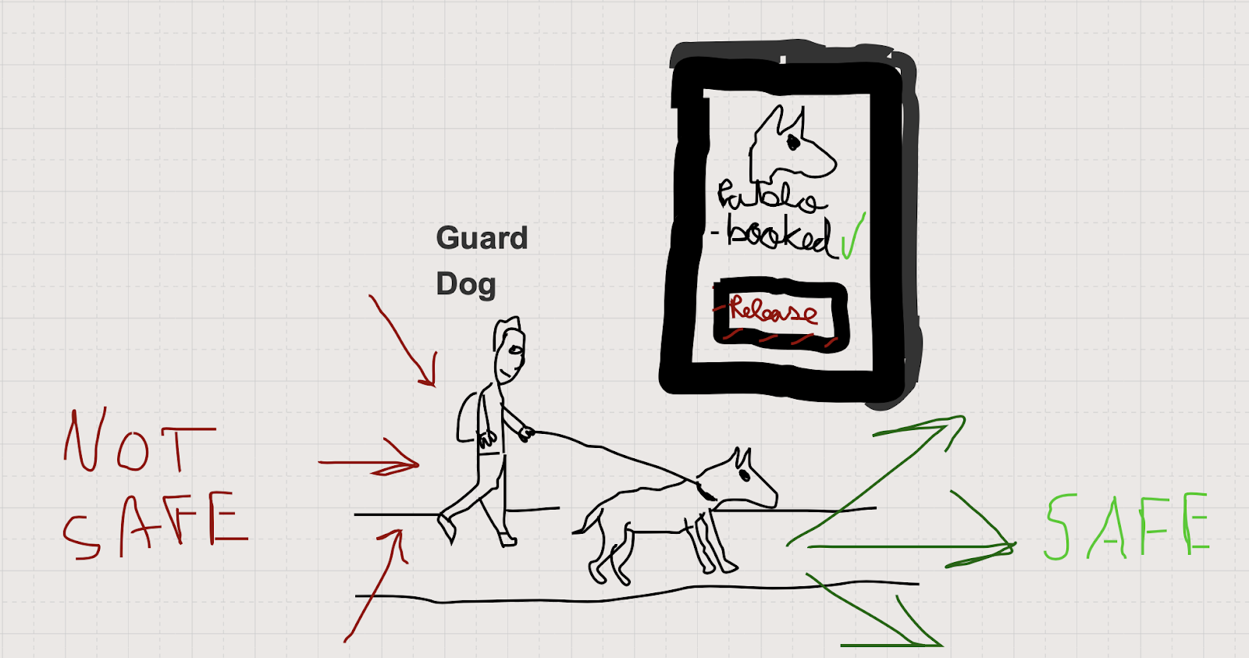
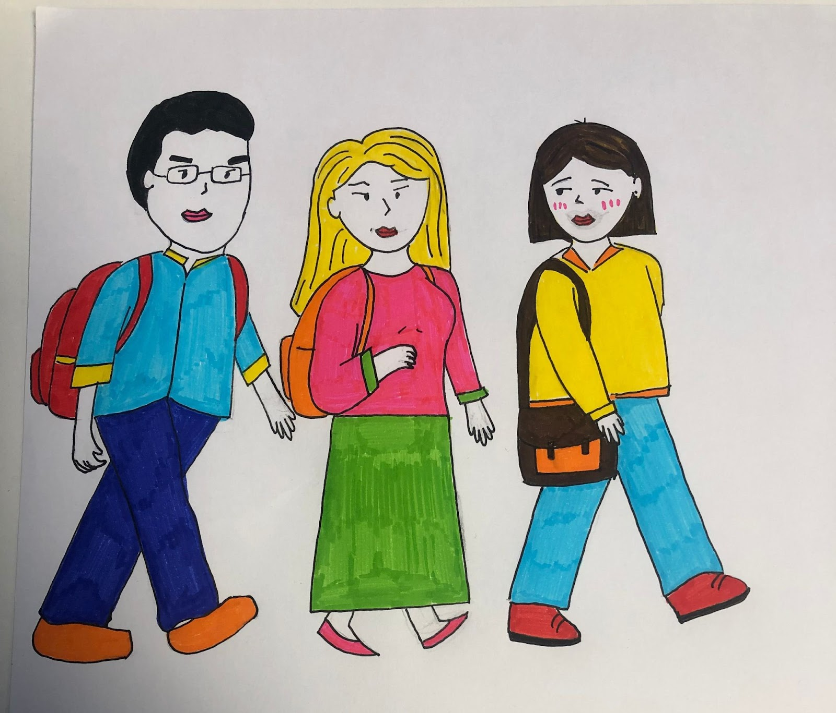
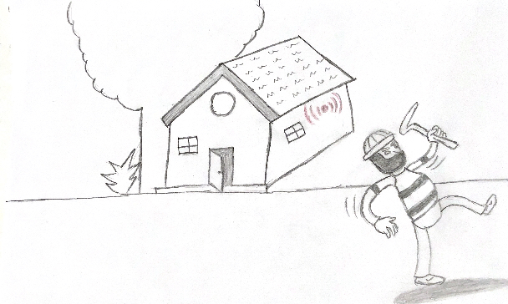
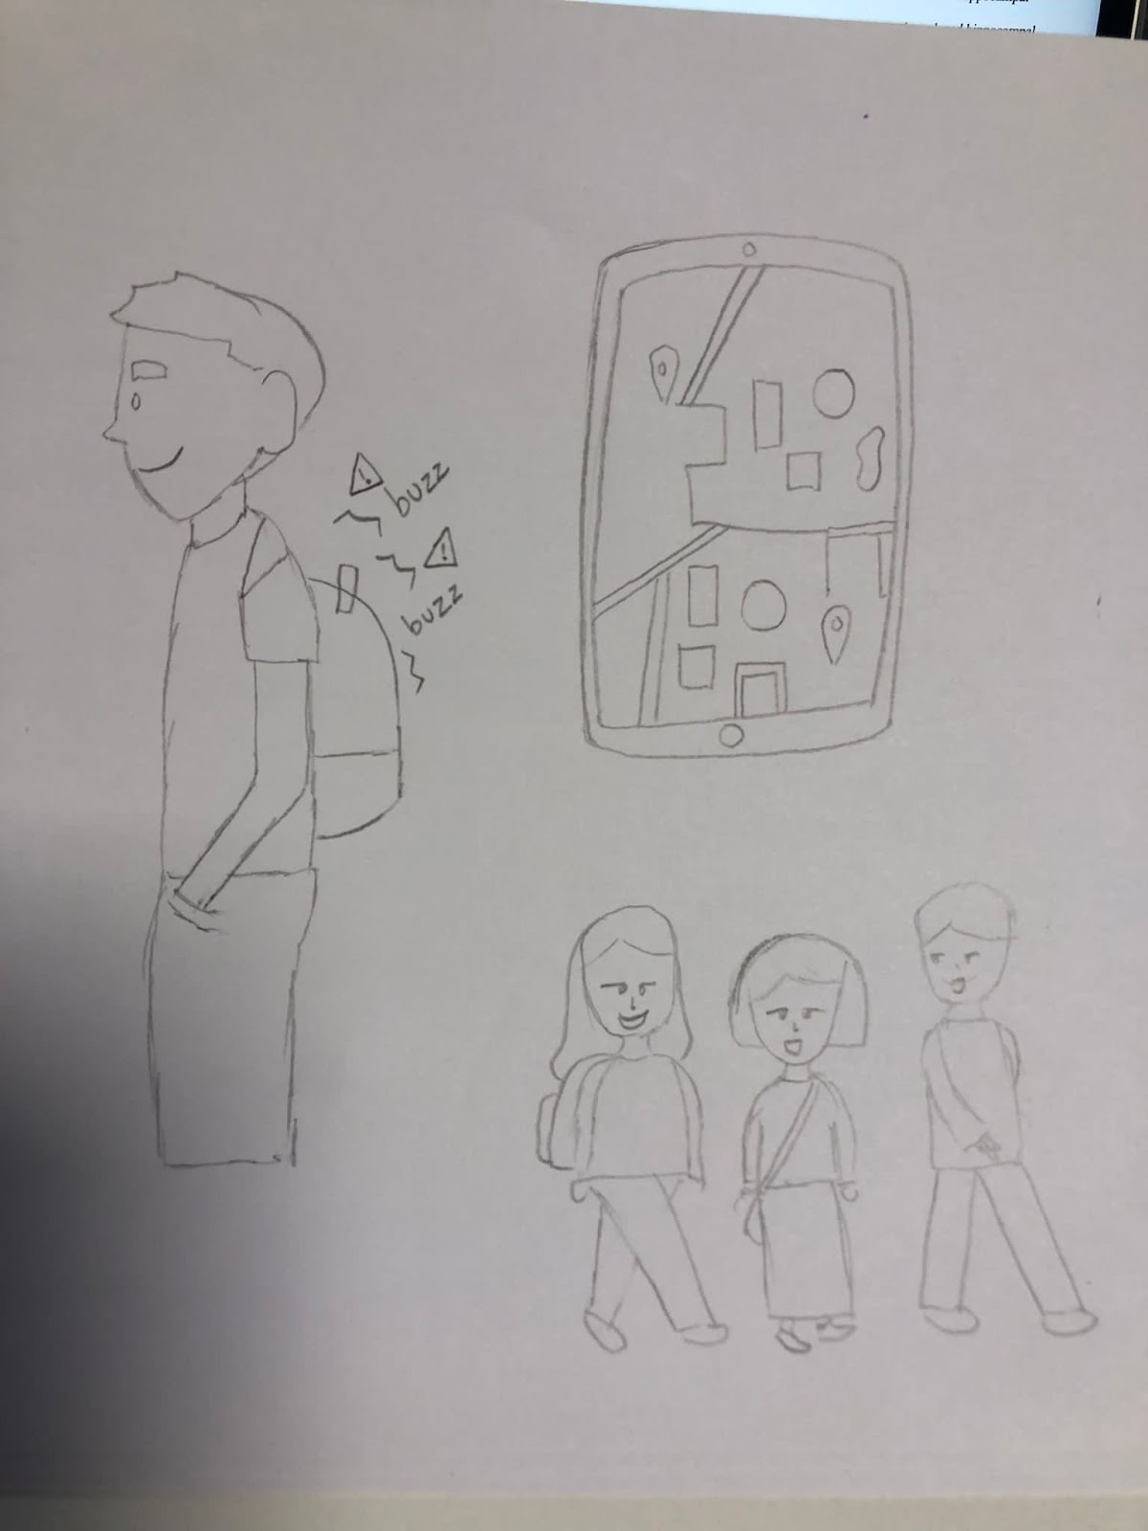
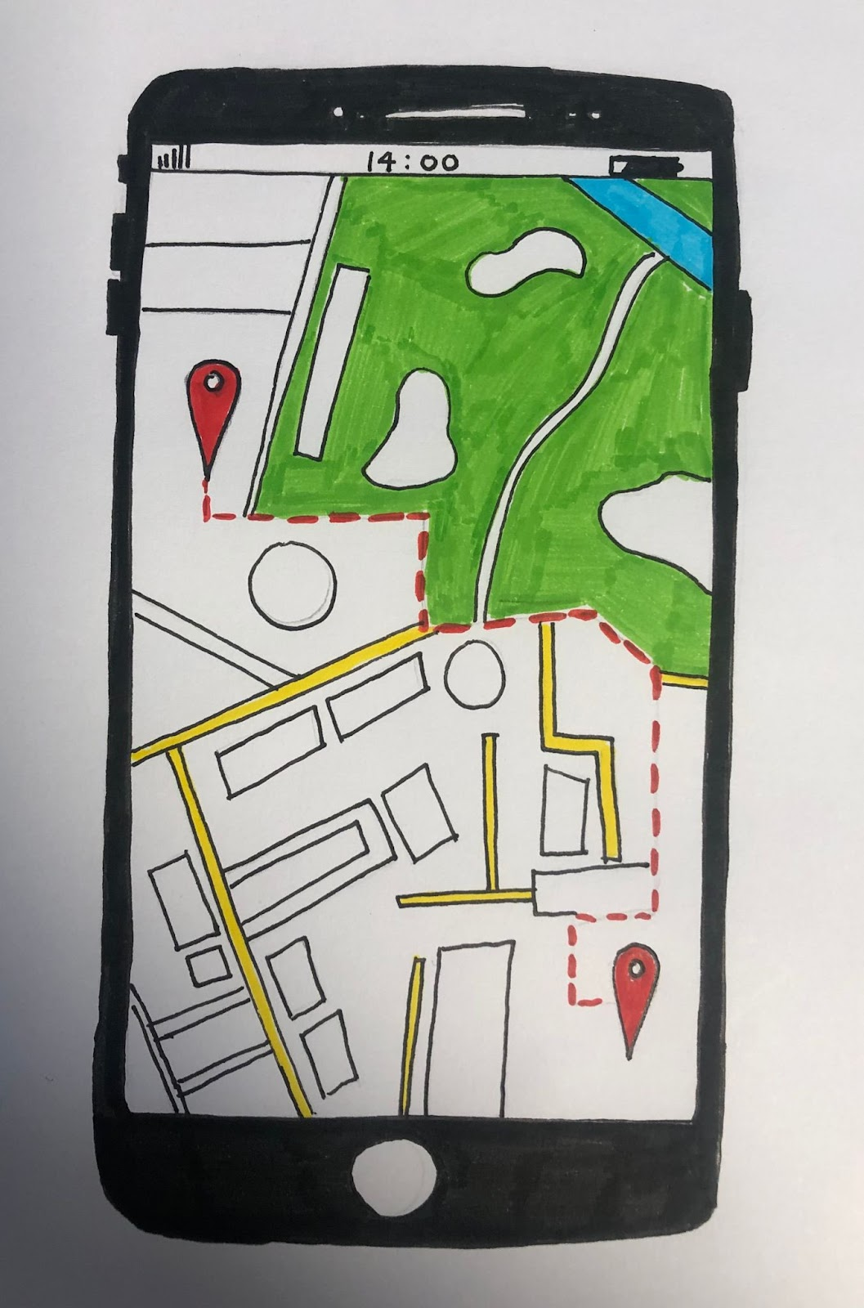
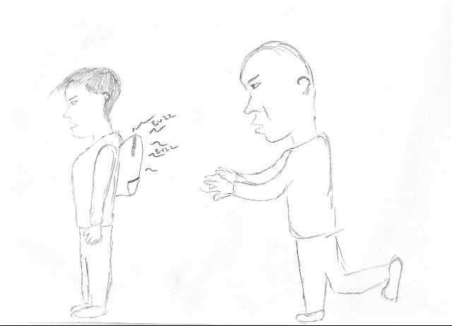
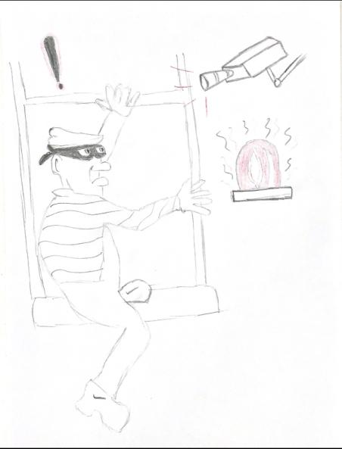
The Six Hats – Accompanying Sketches

Slide 41
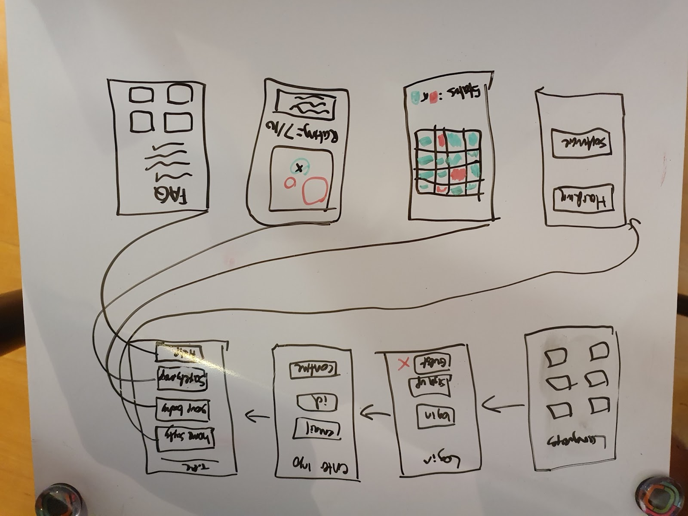
Prototype 1
For this prototype, we wanted to explore using an app with a mobile interface. We wanted our app to be accessible for all students of the University of Birmingham, using our field research we found that some languages would help our users. We decided a login screen was necessary in which users would need to verify their student status using a University email address. This would be important to make sure our information does not fall into the wrong hands. We also added 4 brief categories, Home Safety, Group Booking, Safety Map and Help. We visualized our app to have a simple interface at an early stage to contain easy to use GUIs within each section.
Pros:
Each user will be able to access the app on their personal devices, this already removes a lot of security issues but not all.
A phone may enable users to access more unique and personal features, security features which can be privately viewed.
Can work on a mobile, Wi-Fi and Bluetooth network.
User can remain logged in, assuming phone has a lock system.
User can receive personal tailored notifications about security.
Avoids users having to share a same device.
Cons:
Phone battery is not always reliable.
May be difficult to see full map on small screen.
May not be up to date unless if user updates application.

Slide 42
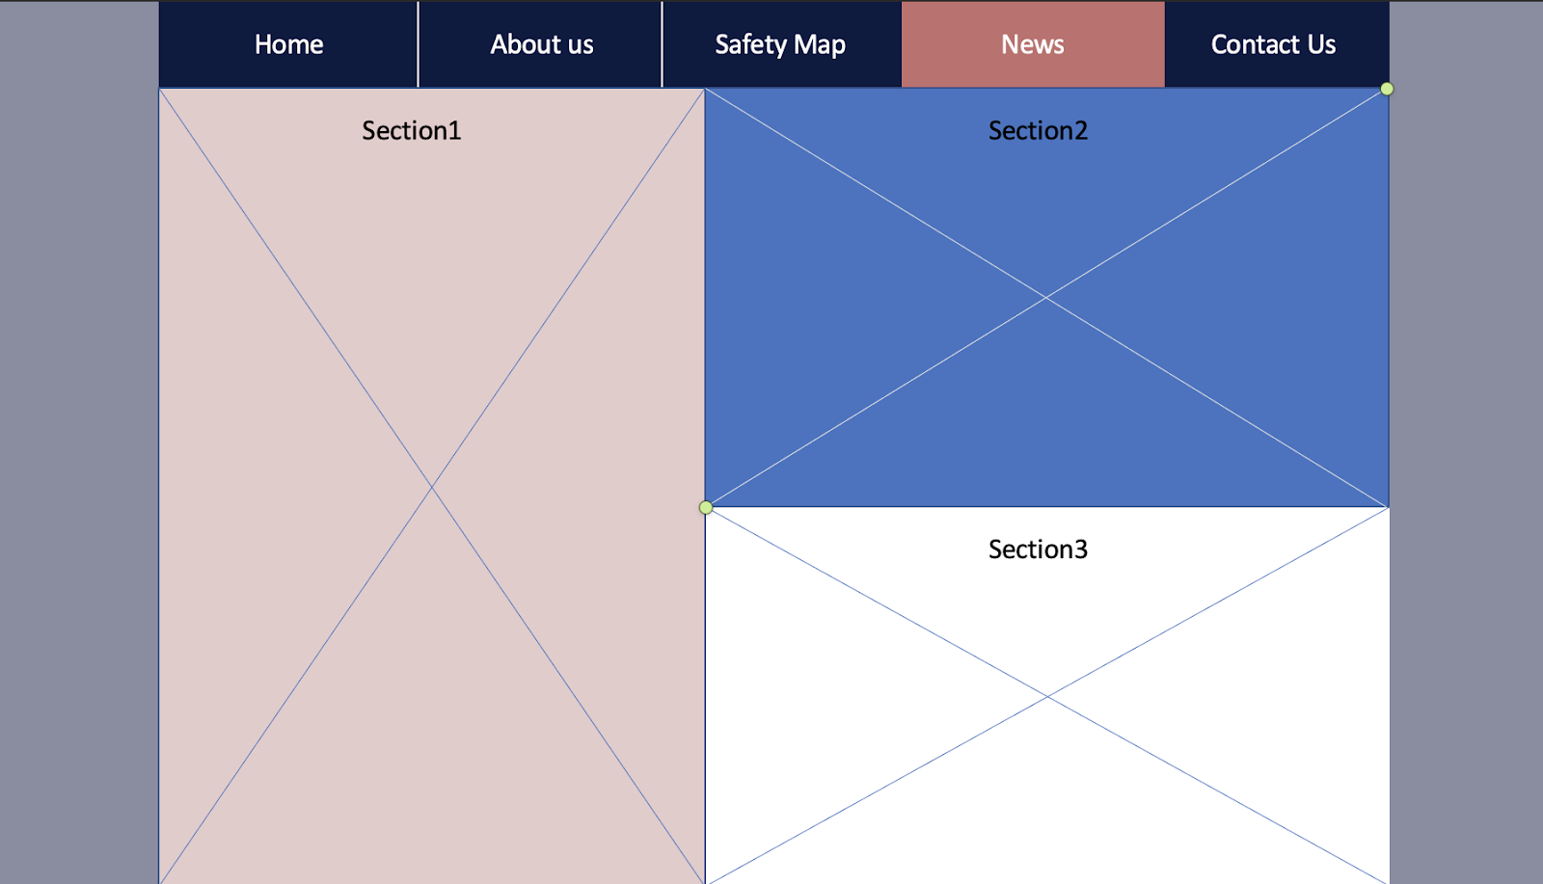
Prototype 2
For the second prototype we decided that we should make a website. The website should have 5 tabs (Home, About Us, Safety Map, News and Contact Us).
Each of those section would provide useful information to the students. Further improvements could include creating an account as well, to improve security.
The news tab should be divided into 3 sections each containing information about:
Latest news regarding to break-ins and attacks happening in Selly Oak.
University safety advices.
The Guild’s advices.
The Safety map should provide information on the following topics:
Recent crimes reported nearby.
Areas with the highest safety risk.
Easy to understand graphs and pie charts to help students understand more of the areas they are interested in.
Pros:
Being able to access the website at any time and check information that you are interested in as a student.
Being able to contact the owners of the website and report incidents to be included in the latest news section.
The safety map can alert students of certain areas before they decide to start a contract on a specific street.
Cons:
The website can be hacked and the servers would be down by the time of the attack.
Doesn’t work without internet connection.
Anyone can connect to the website and see valuable information.

Slide 43
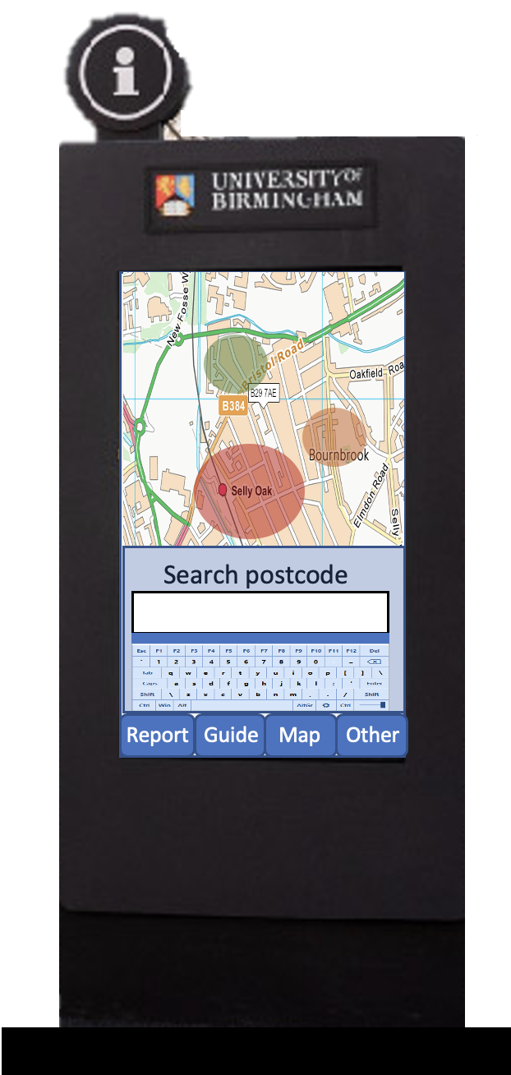
Prototype 3
Being inspired by the digital totems placed around the campus of UoB we decided that it would be a good idea to raise awareness about the safety of Selly Oak by creating a similar device spread around the campus. Several totems would be built around the campus, with the following options for the students:
Being able to see the safety levels of certain areas in Selly Oak.
Being able to report a crime.
Getting advice about safety.
Pros:
It would be useful as students will be able to see advices about safety.
It will trigger awareness because it will be spread all over the campus.
Cons:
Anyone can interact with the device hence why it might be dangerous for this device to be in the wrong hands.
It would cost a lot of money and the University would have to continuously spend resources on maintaining the totem.
Covid can spread through the device.
Not all people can access it all the time.
You have to walk all the way to one of these stations. It might not be the best idea as sometimes you might want to report a crime right away.
The stations are not in Selly Oak.
People may be targeted if they use this machine (they emit fear and insecurity).
User may forget to log out, privacy issues.
Outcome:
After careful consideration and voting, we decided to not go further with this prototype as the number of cons outnumber the pros and because we also considered the costs involved in designing such prototype. The positive things about the prototype we decided to include in the final prototype idea.

Slide 44
Final Initial Prototype Selection
For our very first conceptualized idea of our product, we decided to proceed with Idea 1 through use of the QOC method. We decided to use QOC as we felt it was an excellent way of differentiating our prototypes in our design space analysis. We have put this in the next slide in order to use a full slide. When choosing the prototype, we understood it was of great importance to select the idea with the best prospects. To do this process, we first made the parent node the question, ‘Which Prototype?’ as ultimately we wanted to decide the best option out of the 3 prototypes we have reached as of now. Our options were of course the 3 prototypes. We took great care in choosing the criterion for our selection process. We used the points which we used for each of the ideas in addition to user input which we collated from the questionnaire and interview fieldwork. This was very important as we are following a User Centre Design process. Due to the lack of hardware support and specification of the assignment, we had to remove Prototype 3 from the list immediately. We as a team then assessed the advantages and disadvantages of Prototypes 1 and 2 using the QOC and field research and finally decided to proceed with prototype 1. Unfortunately due to the overlaying effect, we made 3 copies of the QOC slides to make it easier to differentiate between each. For us, ultimately the portability was a distinguishing factor as from our field research, we knew we wanted to incorporate a map feature for students to use whenever they travel home and also we wanted students to be able to access hardware output from anywhere to receive constant live updates.

Slide 45
QOC
Which prototype?
Prototype 1
Prototype 2
Prototype 3
Covid Safe
Personal Privacy
Report Crime
Portable
Safe from public eyes?
Personal Alerts
Always Charged
Push notifications
Emergency contact
Map feature
Easy access
Booking feature
Hardware support
Good screen size

Slide 46
QOC
Which prototype?
Prototype 1
Prototype 2
Prototype 3
Covid Safe
Personal Privacy
Report Crime
Portable
Safe from public eyes?
Personal Alerts
Always Charged
Push notifications
Emergency contact
Map feature
Easy access
Booking feature
Hardware support
Good screen size

Slide 47
QOC
Which prototype?
Prototype 1
Prototype 2
Prototype 3
Covid Safe
Personal Privacy
Report Crime
Portable
Safe from public eyes?
Personal Alerts
Always Charged
Push notifications
Emergency contact
Map feature
Easy access
Booking feature
Hardware support
Good screen size

Slide 48
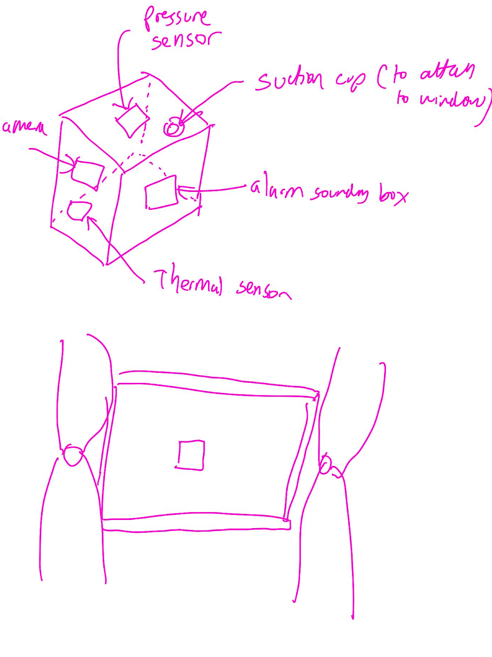
Application Hardware Prototype
For our hardware, we wanted to incorporate a simplistic design which would contain all the necessary features for the safety of our users. Using our field research, we decided to incorporate 4 main features into our design:
A camera which simply links to the Camera section of our app.
A pressure sensor which constantly detects high frequencies of motion e.g. impact of a window being broken.
A built in thermal sensor which could detect heat and allows a clearer view of the camera output in night mode (if a heat source is found, it immediately notifies the user who can check the camera themselves.
A mini built in alarm box which is linked to the pressure sensor and thermal sensor. The alarm is set to sound on default when impact is measured with the sensor but the user is able to enable this is he/she is concerned with the given output from the thermal sensor.
Window

Slide 49
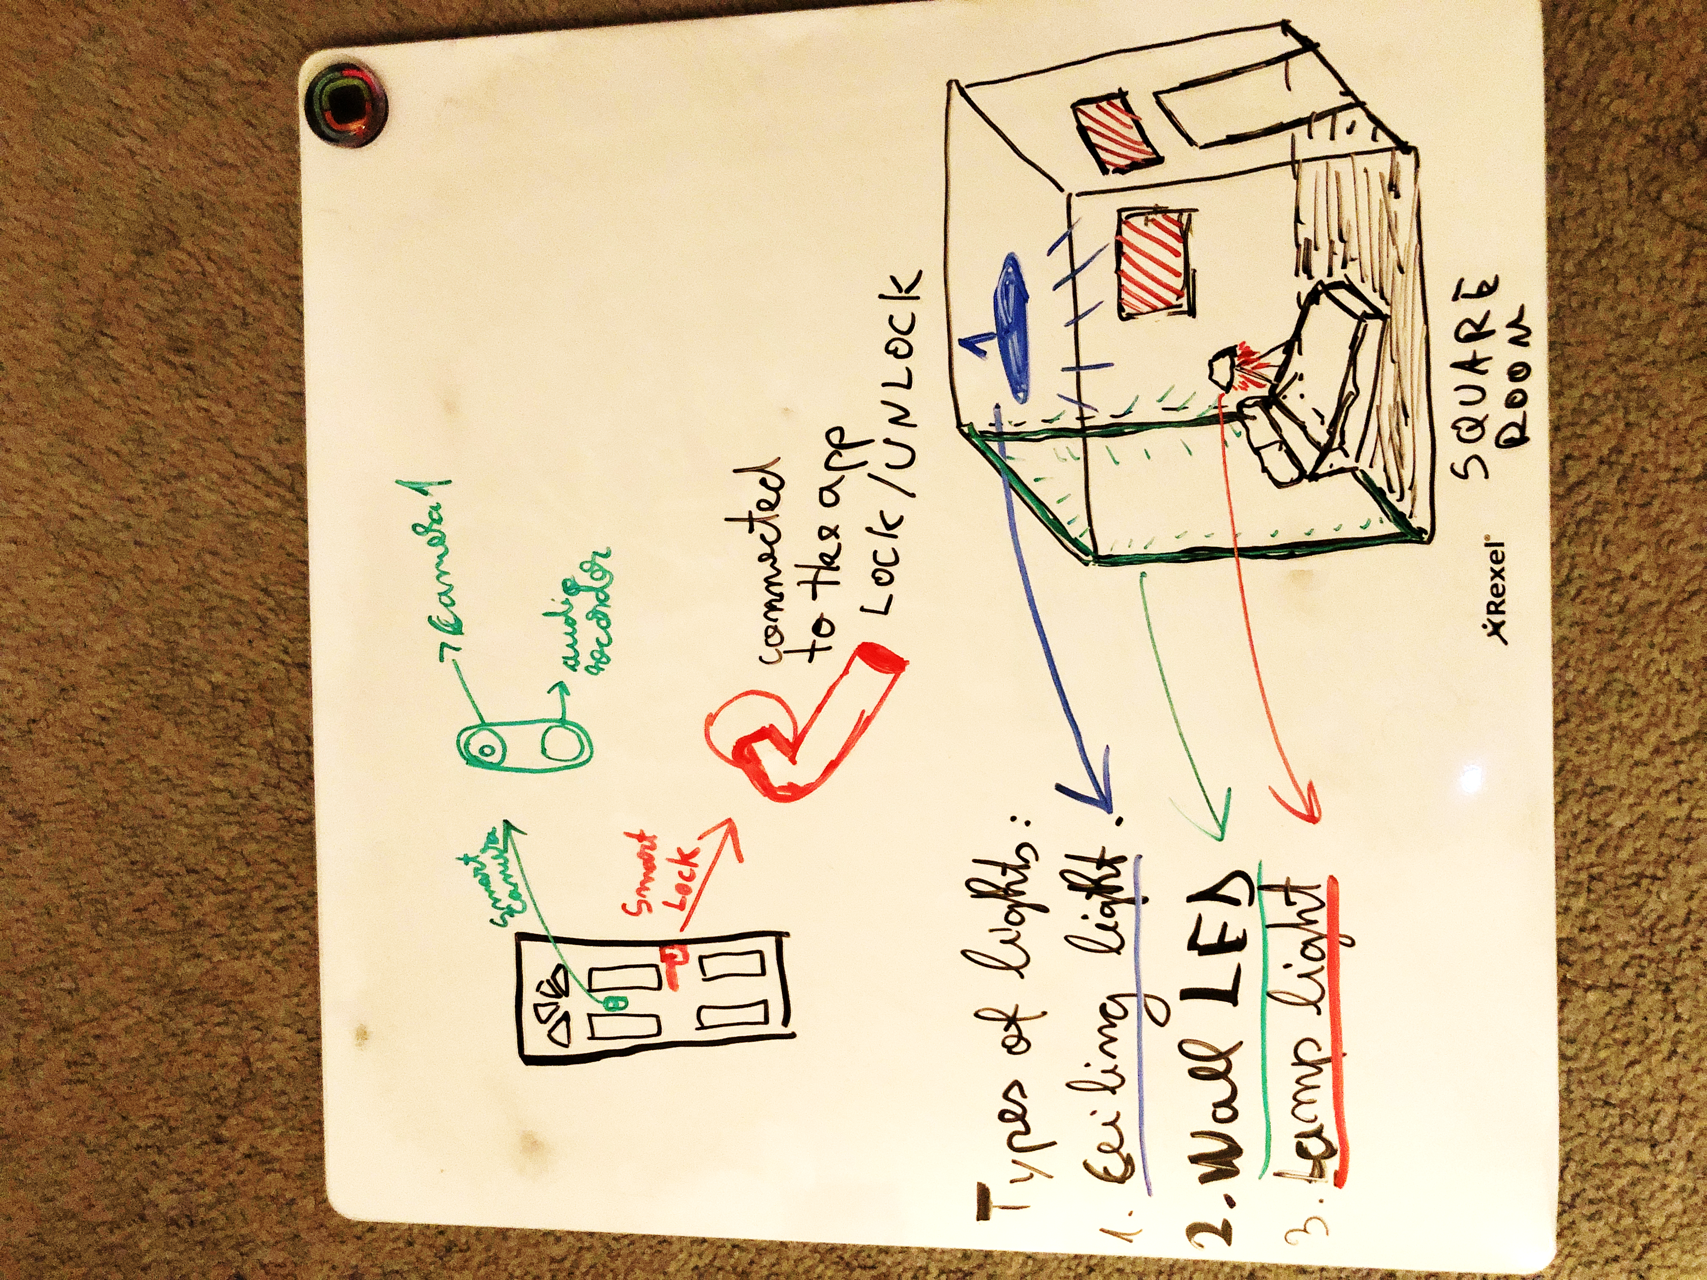
Application Hardware Prototype
In the top left is represented the front door.
We decided to place the camera in the top-middle of the door in order to make sure that we can get accurate images of the potential robber. It is powered by the main source of power of the house, to minimise battery failures.
On every door of the house we have attached a smart lock that is connected to the app and it easily locks or unlock itself based on the user's input. The lock is powered using the main power source of the house in order to minimise battery failures.
For the lighting system we used 3 different types of lights (ceiling light, wall LED, lamp light) located on different places in every room. They can be activated and deactivated easily based on the user's choice. The ceiling light and the wall LED is connected to the main source of power of the house and the lamp light is connected by plug.

Slide 50
Prototype method of Choice
Given the selection of choices to prototype our product, without much debate we all knew that using a form of wireframe would provide us with the best form of presentation for our application. We researched multiple wireframe websites to host our application, and the key distinguishing factor was the ease to use colour in Figma. Balsamiq unfortunately offered black and white modelling, which would not have allowed us to test out various colour schemes. It was very important to us to have this feature as one of our interviewees suffered from colour blindness and we felt it was our moral duty to incorporate this into our app, regardless of the number of people suffering from this condition.
We initially found Figma to be quite tricky to use and there were not as many helpful resources to learn the basics, so we had to dedicate a few hours to understand the purpose of the different sections of the app. We began experimenting the features by creating an app with no relevance to our project whatsoever. Whilst this resulted in an added time cost, long term we felt this would improve our efficiency as it would avoid us having to stop to watch tutorials between iterations and we could fully concentrate on improving of app using our feedback and field research.

Slide 51
Method for testing Prototype
As we had limited access to students who would be willing to test our system, with the addition of Covid, we innovated an idea to fairly test the iterations of our product. We planned on creating iterations as individuals, and for testing, we would randomly provide it to be tested to a team member’s flatmate. This was useful as it would avoid bias of a flatmate being overly nice and not producing constructive feedback. With a team member’s flatmate commenting, it meant that realistic feedback could be received which would help us to create sustainable changes and steer product towards the right direction. Additionally, with flatmates being friends of our team, it meant they were quite willing to help us to complete our testing as opposed to random strangers. Additionally, by working with flatmates, it again overcame the Covid barrier. Additionally, the fact that flatmates were our target audience only served as a bonus and allowed us to verbally discuss our features and make slight but effective modifications. As we were a team of 4, for every 4th cycle we were responsible for making an iteration improvement. Also, every time we randomly assigned a flatmate of a team member which allowed us to gain representative feedback.

Slide 52
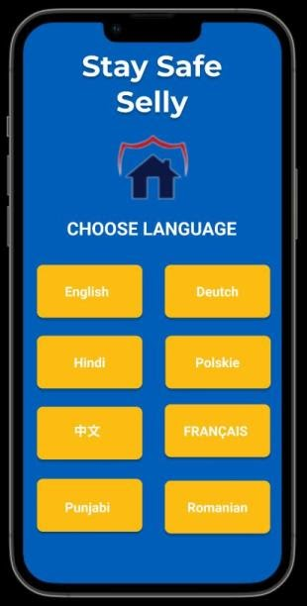
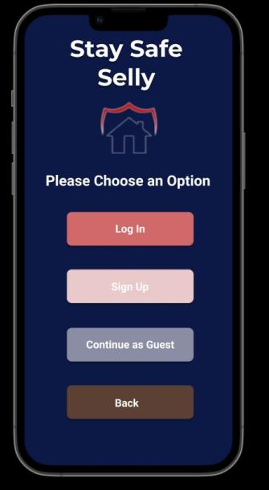
Prototype Iteration 1
We began our app development through the sketch shown in a previous slide. We then explored different wireframe websites. Ultimately, we chose Figma over Balsamiq as we found during our design process that we wanted to incorporate HCI principles such as colour design. After having talked to an individual in our interview who suffered from colour blindness, we decided we want to modify our app, so we would choose colours to encapsulate this. We began looking at our logos and decided it was possible that we could use the colour scheme to reflect on our whole prototype. We first created a colour palette of the colours from our logo and we checked if any of the colours would cause confusion with blind people (This was done using Adobe’s Colour checks). We were pleased to see that our new colour scheme passed these checks. The screenshots for the verification are displayed on the next page.

Slide 53
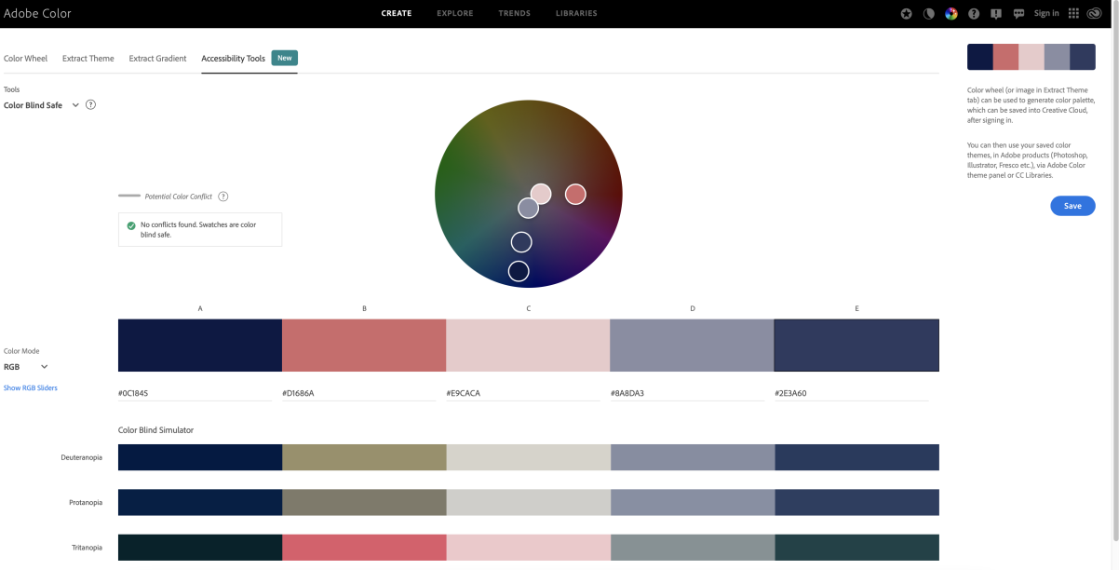
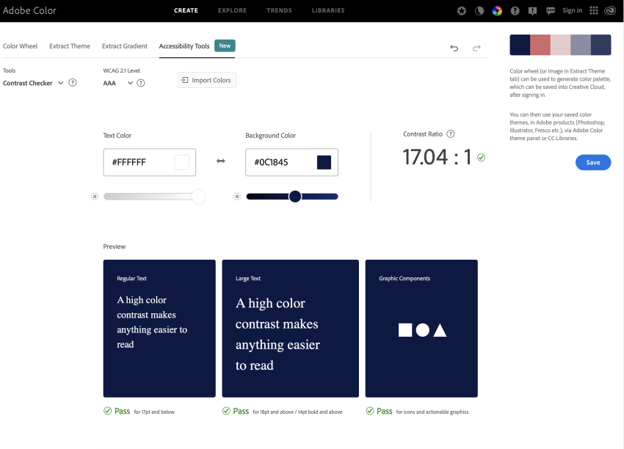
Prototype Iteration 1 - Continued
The image on the left shows the colour palette of our application and evidence showing all the colours are accessible and can be distinguished by colour blind people.
The image on the right shows the colour and font of the text we would use in the future for our application and a grade of the contrast and effectiveness. We chose very good contrasts, those which score highly (AAA) and evidently a contrast ratio of 17.04:1

Slide 54
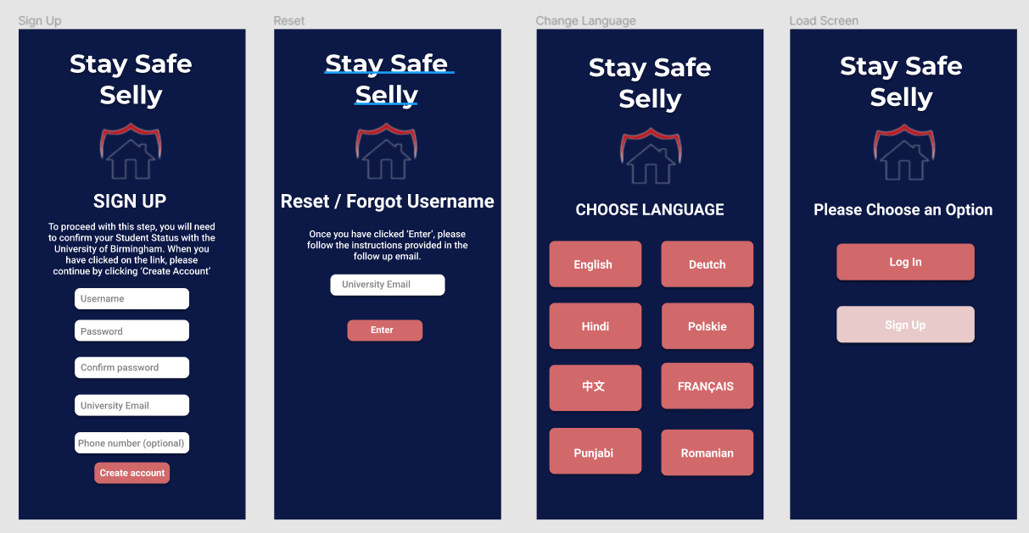
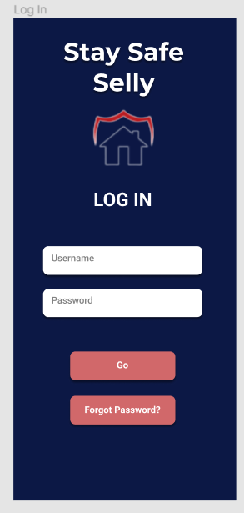
Prototype Iteration 2
For our second iteration we decided to adjust our log in process. We removed the guest option as we foresaw the possibility that a criminal may take advantage of our application’s features by taking advantage of them. For example, an attacker could form a decoy attack to divert attention from students and carry out attacks elsewhere. This was a very dangerous situation which we had a responsibility to mitigate these risks. We came up with a resolution, we decided since our primary audience was the students of the University of Birmingham, all had individual university log ins to exclude themselves from the public.
Although this is not the best solution, at this early stage we felt it was the most secure. We still had in consideration to provide 2 factor authentication or some sort of Face I.D to incorporate into security settings yet we only kept these as potential ideas for our future prototype iterations.

Slide 55
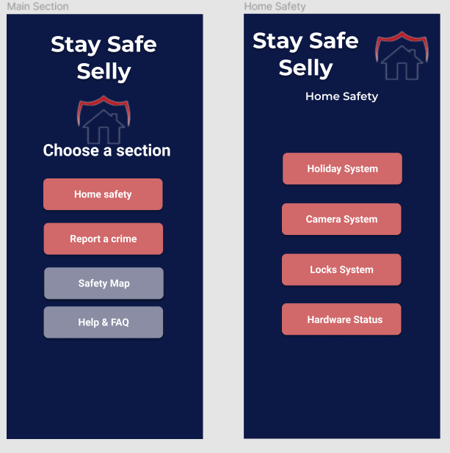
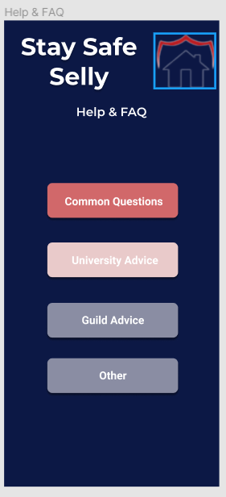
Prototype Iteration 3
For this iteration, we began to dive more deeply into the features of our application by forming a skeleton of the pages. We paid extra attention is avoiding become the user, and for this reason we repeatedly analysed our questionnaires and interviews and annotated specific aspects of relevance. We gathered the following primary topics which would be pivotal for the success of our application, these included; Home Safety, Crime Reporting, a Safety map of some sort and a Q&A feature. At this point we didn’t have a concrete idea as to what we wanted to implement, but having a plan of the pages made it easier for us to develop specific ideas to implement.
For reporting a crime, we had a vague idea of an interface of a GUI of a map which would work in sync with the safety map feature, where a user could pinpoint a location of attack. Because these sections would work in sync, we decided to leave these out for the time being to develop more effective ideas on how to implement these. We began thinking of how to represent zones of danger too for the next iteration, as to whether we should colour roads or create radar zones around certain locations as mentioned in the interview. We planned to have this sorted for either the next iteration or definitely by the one after this. On advice from a team member’s flatmate, we were advised to add icons to aid the HCI, and to make the options more memorable.

Slide 56
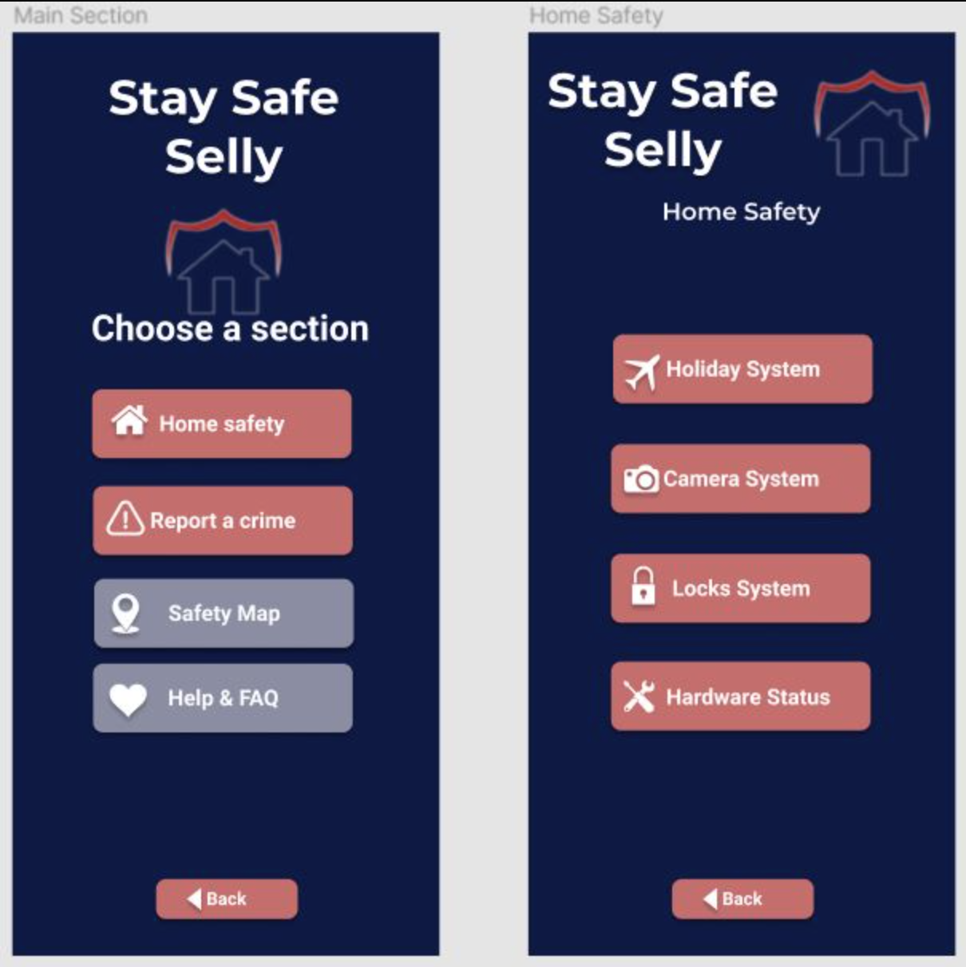
Prototype Iteration 4
Within this iteration, we decided to follow the advice of our team member’s flatmate and we started to include icons in our buttons. We researched the Human Interface Guidelines from Apple IOS Developer finding valuable information about using icons in the buttons. We considered this decision important as most of the users who tried the prototype, associated the meaning of the buttons quicker with seeing a glyph rather than reading the text on it. To avoid ambiguity we decided to keep both of them and we achieved a balance of understanding and a design which is pleasing to the eye.
Another feature that we decided to add into the prototype was the use of a back button with an associated icon. We wanted each page to be in a complete loop, allowing the user to easily localise itself in the app infrastructure. Flat-mates who tried this feature found it very useful as they didn't want to spend too much time figuring out how to get out of a certain page. After we added the Back button they found it much easier to navigate but we also noticed something interesting. Most of them were tapping on the logo.
The last feature that we decided to include in this iteration was a variant of the previous feature. With the use of the feedback from the flat-mates we concluded that people are used to click on the logos in order to get back to the Main Menu. This being said we made the logo responsive to the user's taps which then redirected them to the Main Section page of the prototype.

Slide 57
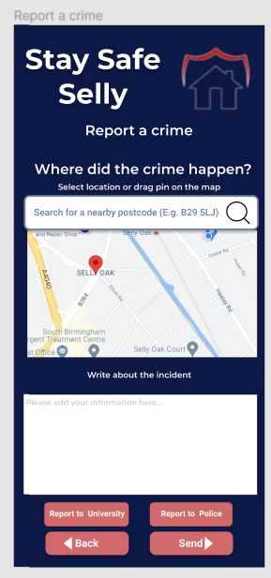
Prototype Iteration 5
For this iteration, we conceptualized the map and ‘Report a crime’ feature of our application. We decided to include the option of messaging both the university as well as the police. We decided to include the university as in our field research, with the University of Kent’s ‘Safe Zone’ app, the university was the first point of contact in the event of the crime so we were inspired by this. We used Google’s API for maps as this was recommended by an interviewee and in our opinion we felt these maps were the most accurate and up to date in terms of location accuracy. We also began to brain storm ideas for the Safety Map feature, we planned for 3 sections; Danger Intensity, Crime Cases and a Prediction feature. We believed these options would successfully align with the requirements of our users who completed our questionnaire and interviews. These features accounted for needs such as being informed about the safety of an area before travel, option to rent a house with confidence (without committing to a contract with no knowledge of the area). Additionally, being made aware of recent crime cases will allow students to be more informed of their surroundings and make safer choices as to which location to travel to.

Slide 58
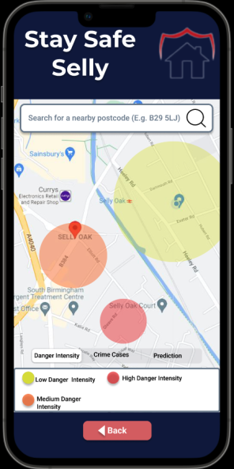
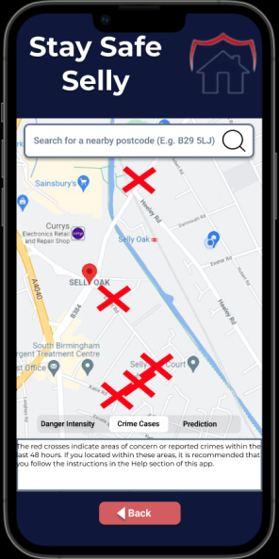
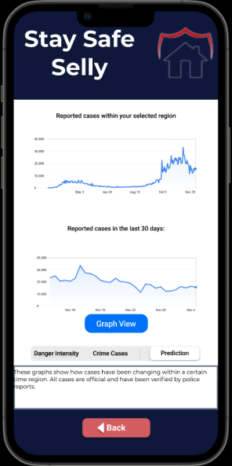
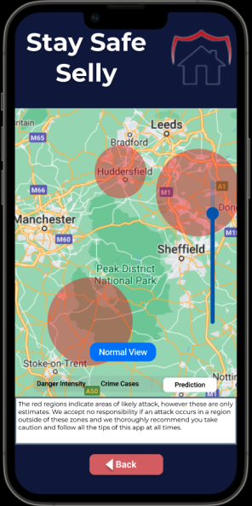
Prototype Iteration 6
For this prototype iteration, we created the Safety Map feature. We were well aware this was a crucial feature, perhaps the greatest selling point of our application. We decided to stick with the ideas we had created from iteration 5, as we felt it was logical and very neatly used information from our User Centred Design model. We wanted to create a simple but elegant UI which would take into account the fact our user has never used our application and would like to easily navigate around the section. We wanted this feature to be effective, efficient and easy to learn. For this iteration, we made an exception to our methodology where we would only allow one flatmate of a team member to test. For this iteration, we allowed 3 flatmates to test to receive as much valuable information as possible and make sure we ace the usability for our map. Ultimately, we decided to use a simple pane with 3 options and a slider to zoom in and out of a map. We decided to use simple but proven principles to achieve this.

Slide 59
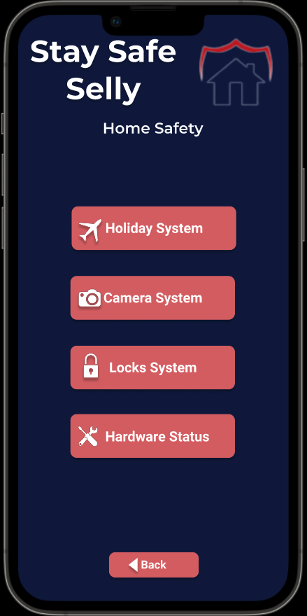
Prototype Iteration 7
This iteration included heavy work on the Home Safety module. Based on the user's requirements we decided to implement four sections:
Holiday System. This section allows the user to change some settings about the hardware devices like the TV, the lights and the sound system. All these settings are used in order to trick the attacker into thinking that somebody is in the house while the tenants are gone in the holiday or they are abroad. (Fig 1.)
Camera System. This section gets the visual information from the cameras around the house and displays in five different frames that can be interchanged. On top of that the user can also see the Safety Risk detected by a specific camera. High risk can be influenced by the movement detection and by how close the person is from the camera. (Fig 2-4.)
Lock System. This section allows the user to lock and unlock certain doors and windows around the house. The user will see a plan of the house with areas that he/she can easily interact with. (Fig 5.)
Hardware status. This section shows valuable information to the user about the status of the main hardware components that make the system work. If one of them has been compromised it can be easily checked. There are also two options to arm/disarm the alarm and to see the logs of the status information. (Fig 6.)
The images illustrating these features will be included in the next slide.

Slide 60
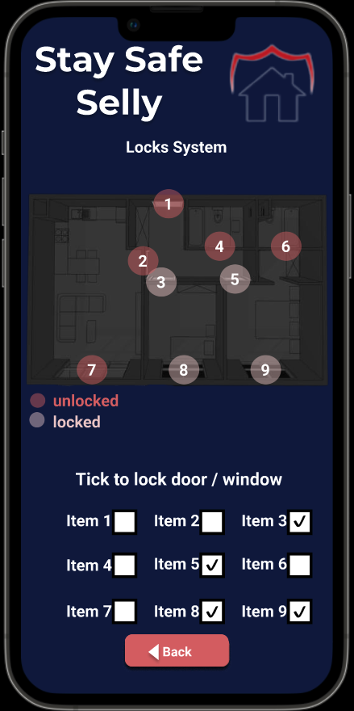
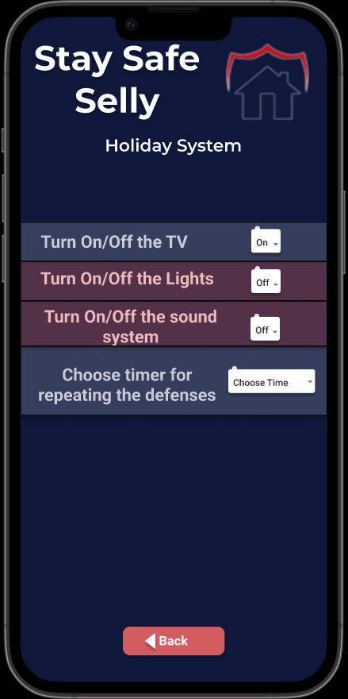
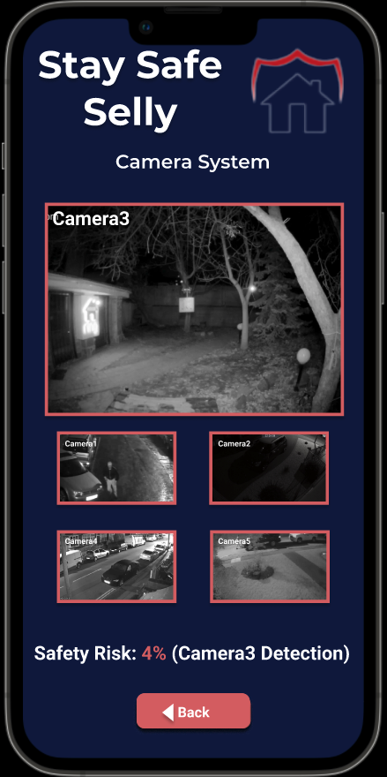
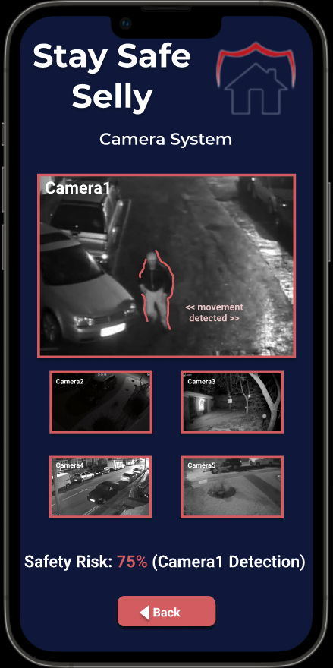


Prototype Iteration 7 Images
Fig 5.
Fig 1.
Fig 3.
Fig 2.
Fig 4.
Fig 6.

Slide 61


Prototype Iteration 8
For this iteration, we wanted to address the issue of a lack of information in supporting students in the event of a crime. For this issue, we dedicated a section of our app to host frequently asked questions and additional websites with advice on how to stay safe. Additionally, we would want to put mental wellbeing charities in this section to further help students who are suffered with depression and PTSD like symptoms from crime aftermath. We decided to include 4 main sections which we believe would cover all sections for the University of Birmingham. These included; Common Questions, University advice, Guild Advice and finally Other advice which would contain mental health services.

Slide 62



Prototype Iteration 9
The last feature that we wanted to implement in the project was the Group booking feature. This addition to the project is supposed to solve the fear that the majority of students felt while having to walk home alone in Selly Oak (based on the feedback from the users). The user will be able to choose a date and a time in order to find a group to walk with on home in Selly Oak. Further settings allow the users to select different criteria in order to ensure that every student feels comfortable with the people that they are going to walk with. This settings include the School within University, the Year of Study, the Sex and the Street in Selly Oak. The latest choice would make it easier for the group to go in the same direction, avoiding one person being left alone after everyone arrived home.

Slide 63
Prototype Iteration Evaluation (Link to Prototype)
To view our complete prototype, please use this link:
https://www.figma.com/proto/1ZOt0MF7XCrfCTtKnYV4n6/HCI-Group-33-Protoype?scaling=scale-down&page-id=0%3A1&starting-point-node-id=2%3A2&show-proto-sidebar=1&node-id=8%3A4
Overall, we consider our application to be a great success. We followed the requirements of our users very closely all throughout the project and addressed all the issues in a unique and creative way. For example, our Home Safety section contains Burglar deterring technology which we added into our hardware. The camera system calculates a risk factor of an intruder, the lock system helps people who forget to lock their doors/windows, such as an interviewee. The hardware status provides reliable feedback as to if any hardware has been tampered with by burglars, again taking into user consideration. The map feature provides an intuitive way for students to prepare the safest route, whilst keeping up to date with the latest crimes so students can minimise their chances of being involved in such activities. The danger intensity provides a qualitative measurement of risk, which could be used by people who are unaware of the safety of a location before initiating a contract. Additionally, the prediction feature can be used to plan a safe journey. The reporting a crime feature has vastly improved existing methods such as reporting on Fab ’N’ Fresh where posts are very likely to be missed. Students can now receive push notifications of such events and easily report events to either the university or directly to the police. The group booking feature was our latest innovation which can be used by students whose schedules don’t align with those who use the Selly Oak bus service. A student can choose whom they would like to walk with and at what time, a search takes place to find a match. If an exact match is not found, the algorithm finds the next likely most relevant match, allowing students to still feel safe. Our app too contains all the features in a simple but elegant fashion, taking into account HCI principles
Our method for choosing how to test has been a significant reason for our success. Every step of the way, we received valuable verbal advice and recommendations on useful and not so useful features. This allowed us to further tailor our application needs to our target audience, right from the questionnaire stage all the way to the final stage.

Slide 64

Class Diagram

Slide 65
Class Diagram Evaluation
A class diagram is a type of Static Structure Diagram that describes the structure of a system by showing the relationship among different classes of the system along with their attributes and operations.
In the class diagram above, we defined all the main components of the system and how they coordinate when working together. All the sensors are connected to the main class called sensors which monitors the activities of all sensors. If any change is detected it updates the alarm box which in turn updates the system and the user is notified.

Slide 66

Flow Diagram

Slide 67
Flow Diagram Evaluation
The flow diagram we used represents a flow and dynamic relationships in our system. We used flow diagrams as they are simple diagrams which helped us to map out the certain process which made it easier for us to communicate with other people. We also used it to analyze and build a step-wise picture of our system so that it would become easier to standardize/improve it.
From the flow diagram above, we were able to show how individual components work. The flow diagram shows how small changes in a certain component can affect the working of the system and what action the system takes based on the changes detected in the account.

Slide 68

Sequence Diagram

Slide 69

Sequence Diagram continued
Unfortunately due to the size of the sequence diagram, it will not fit into one slide. To view it wholly, please use the following link.
https://drive.google.com/file/d/15YArEdBf5HBtpW4dxrBzLhLmHO2q-HB3/view?usp=sharing

Slide 70
Sequence Diagram Evaluation
A sequence diagram is a type of interaction diagram as it describes how and in what order a group of objects/components work together. It depicts the components involved in the system and the sequence of messages they exchange that are required to carry out the functionality of the system.
In the sequence diagram above, we were able to see how the system works. We were able to show what actions/messages are exchanged between the system and components when the user provides different inputs. Through the sequence diagram, we can see what and how each component reacts when different commands are given from the system. Also, we could see that all the sensors and other components were responding to commands of the system that all were connected individually. The diagram provides us the real-time working of components individually according to the system.

Slide 71
Security and Privacy Concerns
We considered the privacy concerns from the beginning of the project when we were in the questionnaire stage, by implementing anonymous entries.
The answers data will also be deleted once the project is done. To ensure ethical standards.
Privacy was considered during the development of the prototype as well by allowing only students to connect to the app interface (through using university emails with confirmation codes).
Another example is when we are allowing the user to choose criteria for the students to be surrounded with if they choose to do a group walking.
For the login system we will make sure to provide the best security to avoid hackers getting access to the valuable information. Some of the techniques include hashed and salted fields in the database, brute-force defences, XSS defences etc.

Slide 72









Logo Design Prototypes

Slide 73
Explanation of Logo choice
To design the logo, we started by identifying that the project was going to be specifically related to home security. We all came up with different designs, and we shortlisted all of the good ones to the slide above.
We selected this particular logo among all the designs because we wanted our logo to be both simple and expressive at the same time.
With this logo, we serve our customers in every aspect where they clearly understand what we offer. The red shield represents the protection and the house represents what we aim to protect.
In terms of design, the logo is very basic but it is expressive enough for the user to understand what the project is. In regards to the specific colour, we had many options but chose blue because blue represents trust and we aim to build trust with people. Also, we matched the colour of logo with UI of the app as the colours are compatible with colour blind people and represent out values.

Slide 74


Poster
We started making a poster with a basic template that included all our key points and some pictorial representation of the same.
As we worked on it we were able to figure out that mostly what things people want to know first-hand.
We included a general idea of what ‘Stay Safe Selly’ is and the prime features that we were providing.

Slide 75


Poster Refined
In this version we decided to use the colour scheme of our application and logo, and used a simpler design to reduce the cognitive load of users who observe our poster. We feel we have achieved this through creating 5 quick and easy points, well contrasted with the background, and catchy memorable phrases.

Slide 76

Project advertisement

Slide 77
Project Advertisement Evaluation
For further advertising we decided to create a video as well. We decided a lot of wording is not needed as we can keep the audience more involved by using catch phrases with big font values using a colour that is easy to read with the video in the background.
For the sound we used intense music to give the viewer the feeling of walking through the streets of Selly Oak at night.
The images used in the video are posts by students who experienced break-ins and also articles from the internet to highlight the issues of Selly Oak regarding the safety of the students.
For the script used for the voice-over we decided to split the text into 3 categories (Scenario, Problem, Solution). Each of these categories were used in the video advertisement in consecutive order.
We decided to keep the video short and concise in order to make the viewer curious to find more information about the scope of the project (which they could easily do by following up with the information displayed at the end).
We found this stage very useful and the feedback was positive from the people that we showed this video to.

Slide 78
Teamwork
As a group of 4, we unfortunately began with a slow start. However, due to excellent leadership and cooperation within our team, we boosted each other's morale quickly and didn’t look back. We followed specific goal orientated plans throughout the project to achieve measurable outcomes and maximise our performance.
We made sure everyone was working on a set of weekly goals that were evenly distributed using Trello. We used Trello to its maximum capability to maximise our efficiency and make sure everyone was assigned tasks. It was also good in allowing us to see if members were struggling with workload, in this case we would further divide remaining work to ensure all deadlines were met swiftly and smoothly. During our weekly discord calls, we followed scrum styled meetings to ensure everyone was confident in their task for the week.
We all agreed as a team, we worked very well, we understood each other's strengths and weaknesses and used this knowledge to our advantage to advance in our project. We assigned tasks accordingly to make sure we were motivated and passionate to complete our given tasks to the best of our ability. If such that a team member was struggling, it was noticeable that team members would go out of their way to provide help, often sacrificing free time and working out of office hours to aid.
The organization and dedication of the team made what would be a difficult and strenuous project, a fun and rewarding experience where we developed invaluable skills which will not only benefit us in our University journey, but our careers beyond this scope.

Slide 79
Project Conclusion / Summary
Over the duration of this project, we are proud to say we accomplished and learned a lot of valuable concepts and information.
One of the greatest lessons we learned was the importance of using a strong model at the start of a project (in our case, the User Centred Design), the value of dedicating time and effort during the question developing stage of the Questionnaire to receive rewarding and impactful feedback and the value of communicating effectively and extensively with our target audience in our field research.
We also appreciated the benefits of working solely as a team, through constructive criticism and healthy debate, we were able to expand our ideas to new heights every meeting.
In hindsight, we as a team agreed we could have made better management to our time skills earlier on in the project. This could potentially have resulted in more time being spent in the questionnaire and ultimately more finely tuned answers. This could have had a dramatic effect on the outcome of our project. Regardless, we are proud to have created ‘Stay Safe Selly’ and hope one day it has the potential to improve the wellbeing of the students of the University of Birmingham.

Slide 80
How would you improve this product?
In terms of improvement, if we were given the chance to repeat this project, we would have most certainly liked to dedicate more time into the questionnaires. Rather than us vividly saying improvements from our own accord, we believe the best advice would have come from the potential users of our product who could have provided us with subtle guidance in which direction to follow within the course of the project.
We would have also liked to have carried out more field research, following the different techniques which were explained in the lecture materials. We as a team believed, where there is no time constraints, you can never have too much field research. The more research we could collate, the better our idea of our audience and the more valuable information we could have applied to the various models we used within this project.
Otherwise, needless to say, we are extremely proud of our final product.

